Slide 1
Meteorological and Oceanic Observation System as a Tool to Promote Resilience and Adaptation to Climate Change in the Cooperation Space (MAC-CLIMA)
(MAC2/3.5b/254)
1st MAC-CLIMA on-site event
December 1-2, 2021
Las Palmas de Gran Canaria (Spain)
THE 85 PER CENT OF THE PROJECT IS FUNDED BY FEDER FUNDS

Slide 2
CONTENTS
01
02
Activity 2.1 Vulnerability Analysis and Adaptation Measures
Activity 2.2 Policy Proposals and Adaptation Regulations
03
04
Activity 2.3 Strengthening of capabilities
Activity 3.3 Awareness-Raising Strategy

Slide 3
01
Activity 2.1 Preparation of an analysis of the vulnerability to climate change in the different regions of the cooperation space and implementation of the appropriate adaptation and mitigation measures to address the risks resulting from climate change and reduce the vulnerability of the different key areas and industries in the cooperation space.
Studies on the impact of climate change on the industrial water cycle and the water infrastructure (increase of the water temperature, impact on water catchment, forecasts of increases in water demand, forecasts of floods, etc.) 🡪 Study of cases in the Canary Islands, Porto Santo (Madeira), Cape Verde.
Vulnerability analysis of the comprehensive urban water cycle and general proposals for mitigation and adaptation measures 🡪 Case study from Northern Gran Canaria and Santiago Sur (Cape Verde)

Slide 4
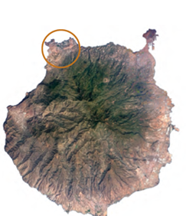
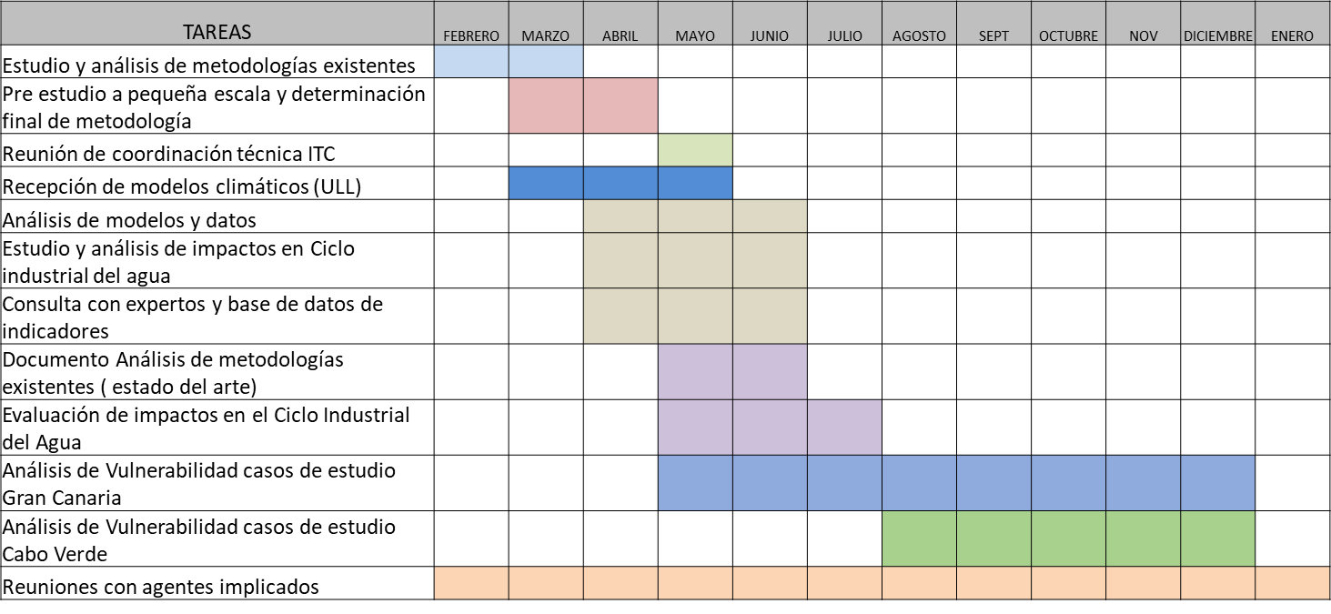
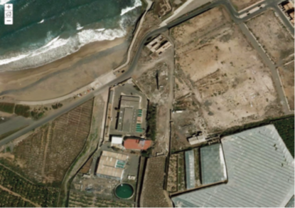
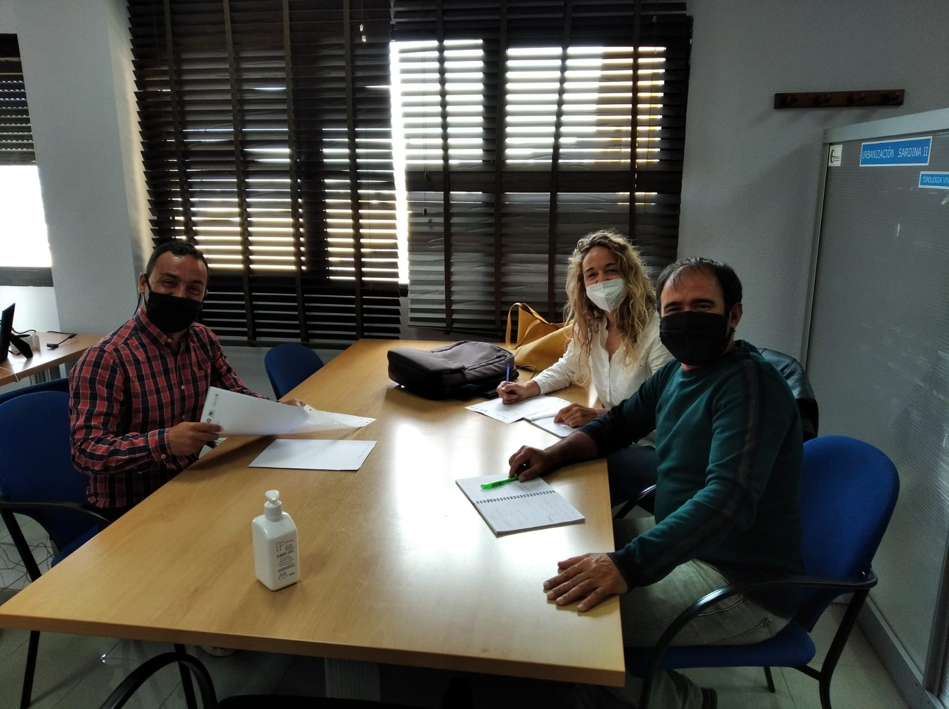
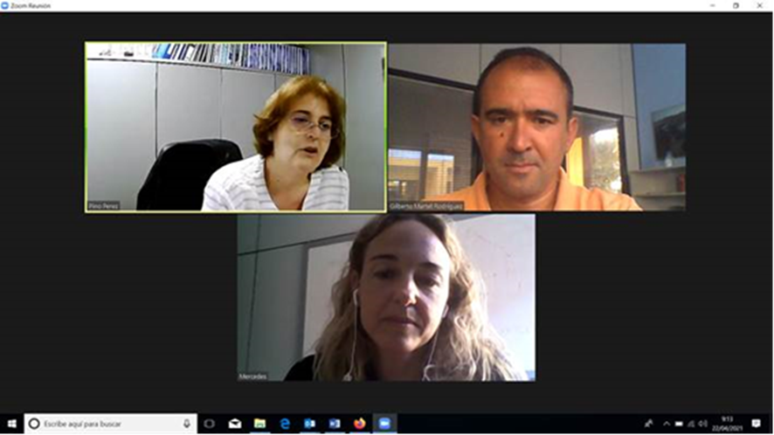
01 Vulnerability Analysis and Adaptation Measures
€1,757,54,28
36
12
Existing Study Analysis
Action timeline
Demarcation of the study area
Methodology application test (Water Desalination Plant in Bocabarranco, EETP Guía – Gáldar)
Document of Methodology Analysis for Assessment of Risks and Vulnerability to Climate Change
RIVUCAN Synergies and Definition of RCP scenarios
Technical meetings:
ITC
Council of Gáldar
Water Council of Gran Canaria
Direct-Gen. Water Govern. Can. Isl.

Slide 5
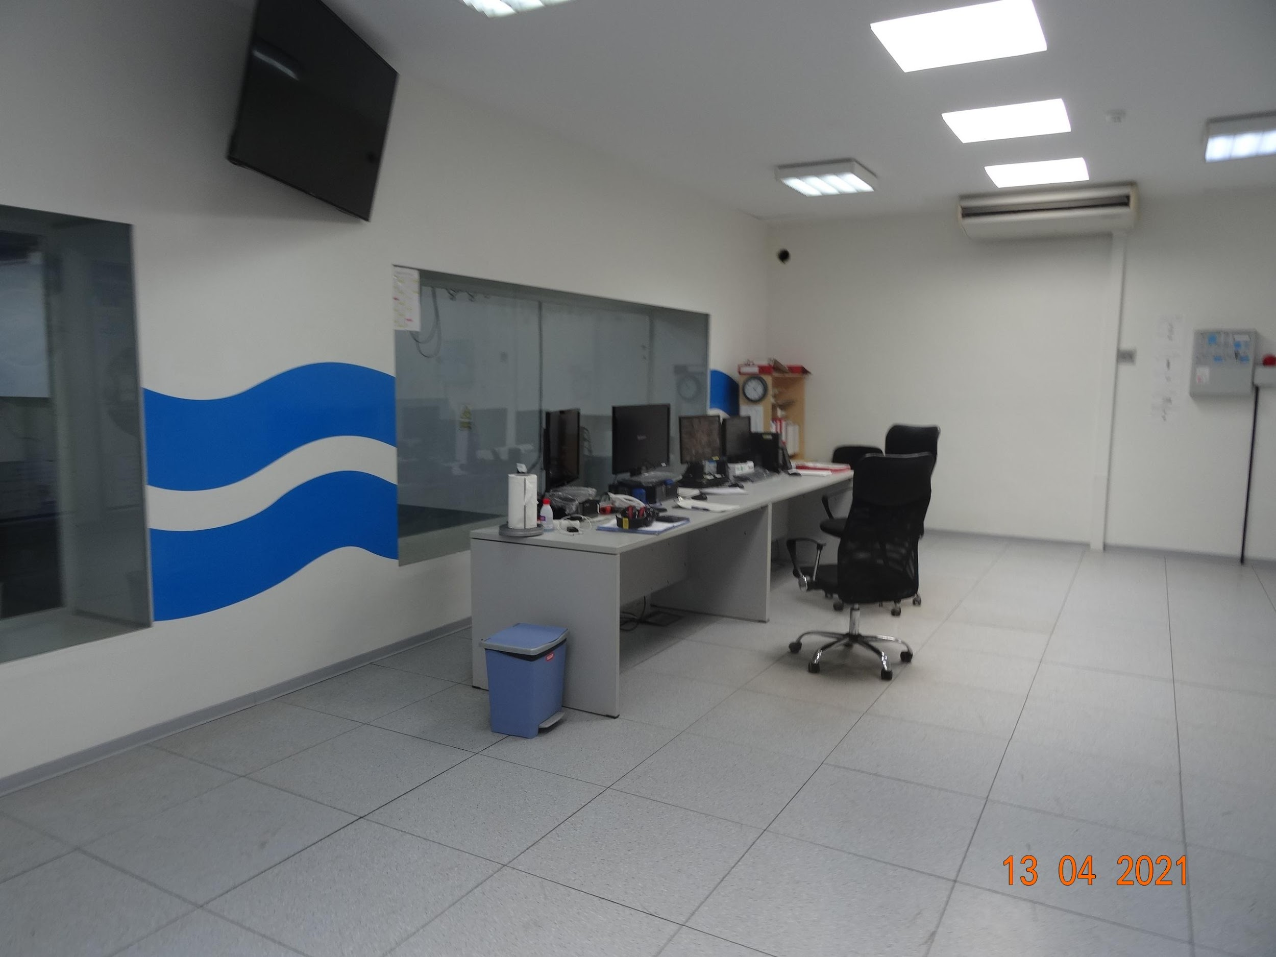
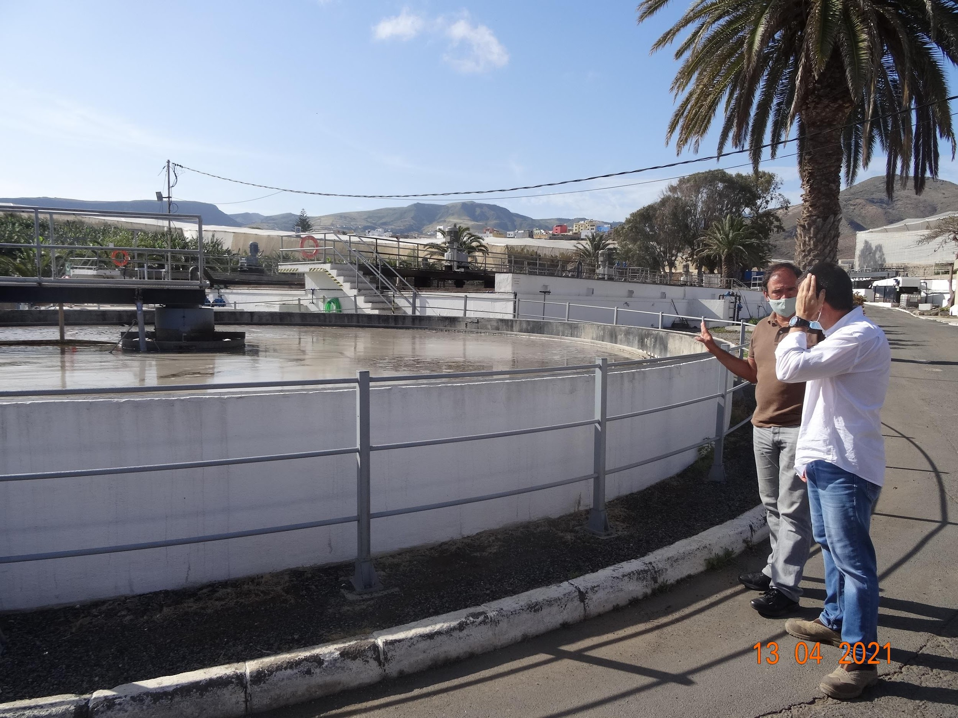
01 Vulnerability Analysis and Adaptation Measures
€1,757,54,28
36
12
Document of Analysis of Climate Variables and their Potential Impact on the Industrial Water Cycle.
Climate threats in the study area
Visit to infrastructure
ITC technical meeting
Risk indicator database
Literature review and advice from experts
Synergy from MITIMAC project Carbon footprint calculation.
Document with the methodology and outcome of the Carbon Footprint Calculation of the Wastewater
Treatment Station (WWTP) Guía-Gáldar

Slide 6
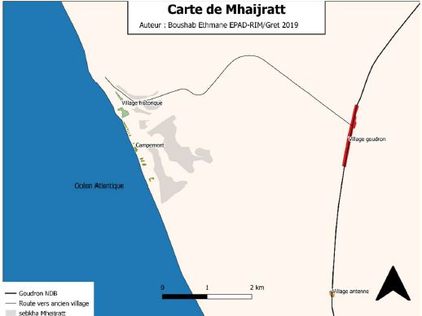
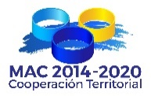
01 Vulnerability Analysis and Adaptation Measures
€1,757,54,28
36
12
Request for collaboration with RESCOAST project
Technical meeting, demarcation of the study area.
Visit to the study area (December 2021)
Vulnerability analysis
Adaptation proposals
Regulation proposals
MACCLIMA consultation
Literature review and proposals for action.
Planed for March 2022

Slide 7
01 Vulnerability Analysis and Adaptation Measures
Vulnerability analysis
36
12
Document of analysis of climate variables and their potential impact on the industrial water cycle.
€1,757,54,28
Risk indicator database
Adaptation measure proposals
Document with the methodology and outcome of the Carbon Footprint Calculation of the Wastewater TreatmentStation (EDAR) Guía-Gáldar
Document of analysis of climate variables and their potential impact on the industrial water cycle.
Definition of Eco-ordinances (Activity 2.2)
Finished
Planed for June 2022

Slide 8
02
Activity 2.3 Strengthening of the capabilities of the local and regional public organisations in order to develop and implement measures intended to prevent and mitigate the adverse effects of climate change.
Remote training courses on Introduction into Climate Change and Mitigation and Adaptation Strategies (based on the ADAPTaRES experience, in 3 languages, to be launched in all the regions).

Slide 9
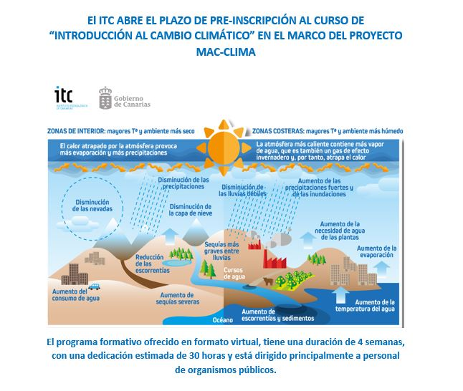
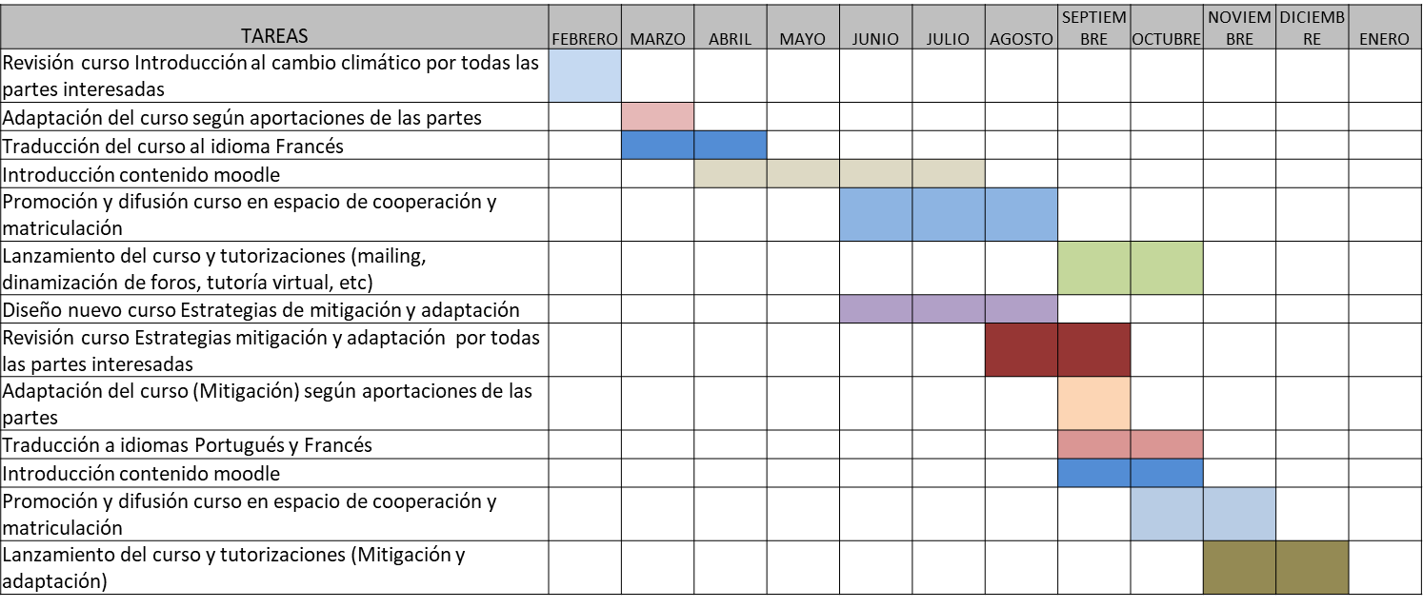
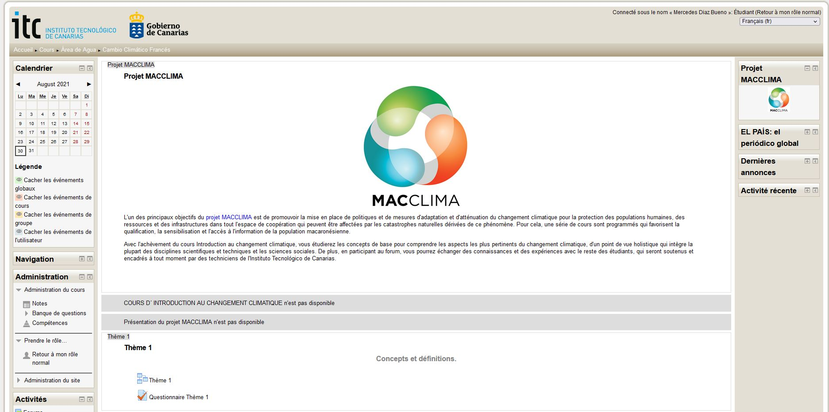
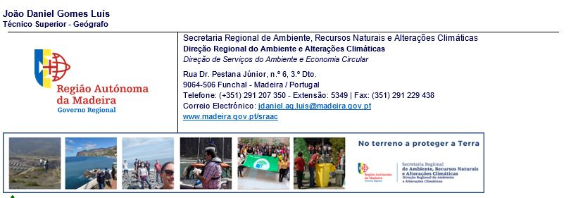
0.2 Remote training courses
“Introduction into Climate Change”
€1,757,54,28
36
12
Review and contributions
Timeline
Public announcement and pre-registration
Outcome report
3 languages
250 applications
141 Admitted
80 certificates of completion
Average general assessment
4.3/5
Amendments and translation into French
Remote training platform
Tutorship and assessment
Completed November 2021
http://teleformacion.itccanarias.org/.

Slide 10
02. Remote training courses:
Outcomes
Version in Spanish for the Canary Islands:
- 100 applications ( 45% Gran Canaria, 38% Tenerife, 17% rest of the islands).
- Universities of Las Palmas de Gran Canaria (ULPGC) and La Laguna (ULL), public company Gesplan and Cabildo de Tenerife. All the island councils (cabildos) were represented.
-34 Admitted.
-All the islands were represented.
- 24 certificates.
- Average mark: 8.14.
Version in Portuguese for Madeira and Cape Verde:
- 72 applications ( 51% from Madeira and 48% from Cape Verde).
- Teaching staff from schools, universities and prisons. Entities with the highest demand: Directorate of Environment and Climate Change (DRAAC) of Madeira and National Institute of Meteorology and Geophysics of Cape Verde.
- 72 Admitted.
- 40 certificates.
- Average mark: 8.70
Version in French for Mauritania and Senegal:
- 35 applications ( 60% from Senegal and 40% from Mauritania).
- Teaching staff from universities and from the National Aviation Agency of Senegal (ANACIM), the Directorate of Land Surveillance and Control of Senegal (CSCOS) and the Ministries of Environment and Sustainable Development and Agriculture of Mauritania.
35 Admitted.
- 19 certificates.
- Average mark: 7.64
€1,757,54,28
36
12

Slide 11
02. Remote training courses:
Outcomes
Canary Islands
36
12
Cape Verde
Madeira
Mauritania
Senegal

Slide 12
02. Remote training courses:
Outcomes
Valuation of the platform
4,3/5
36
Quality of course content
4,4/5
Average general assessment
4,3/5
Degree of updating of the course contents
4,23/5
Level of teacher participation.
3,9/5

Slide 13
“Climate Change Mitigation and Adaptation Strategies in the production, distribution and use of water” course.
Preliminary contents are already written
02 Remote training courses:
“"Climate Change Mitigation and Adaptation Strategies in the production, distribution and use of water"
€1,757,54,28
36
12
Call for contributions
Theme Structure
Theme 1. Climate change in the MACCLIMA cooperation area.
Theme 2. Climate change and hydrological cycle.
Theme 3. The industrial/urban water cycle. Mechanisms of exploitation.
Theme 4. Mitigation
Theme 5. Mitigation strategies.
Theme 6. Adaptation Risk and vulnerability analysis
Theme 7. Adaptation. Strategies
Theme 8. Tools to promote the sustainable management of water resources
Theme 9. Water policies
Case Study
Request for collaboration Review of translations.
Planned for March 2022

Slide 14
03 Activity 3.3 Awareness-Raising Strategy
03
Activity 3.3 Development and implementation of an awareness-raising and spreading strategy in order to improve the knowledge associated with climate change amongst the citizenry, the local administration and the business entities in the cooperation space
Collaboration for the preparation of the strategy from the experience gained by ITC. Sharing of knowledge and documents.
Adaptation and leverage of existing information materials and tools that had been previously developed for other projects.
Willingness to participate in any information actions that may be defined.

Slide 15
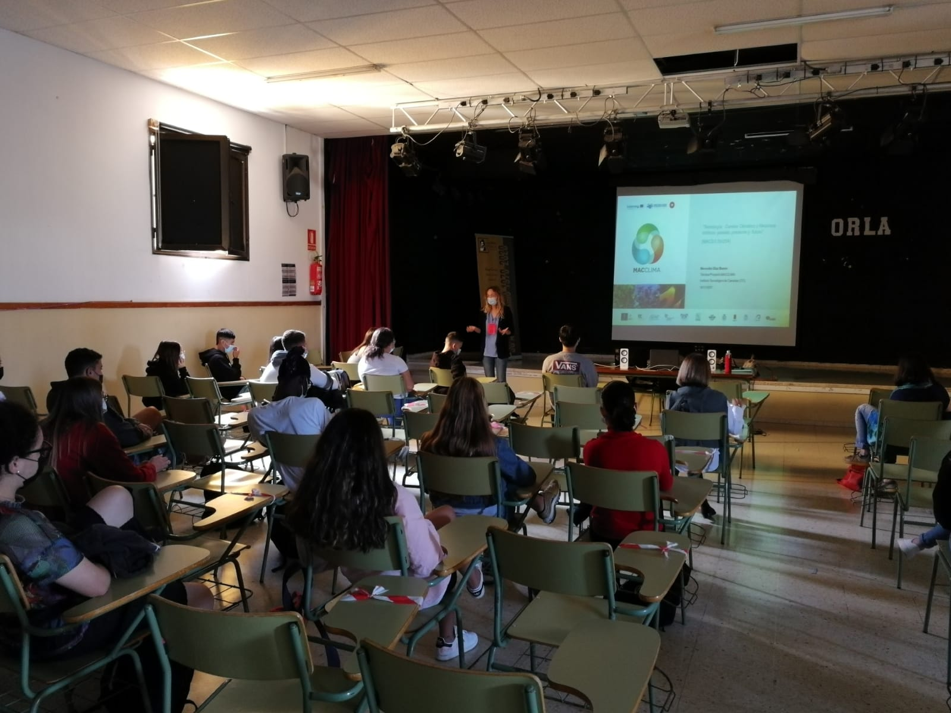
03 Activity 3.3 Awareness-Raising Strategy
Different didactic, awareness-raising and training tools have been developed, adapted to the Canary Islands, Cape Verde and Madeira, focused on raising awareness about climate change adaptation strategies and drought risk prevention.
Use of contents
Participation in the 5th Innovation Workshop at the secondary education school IES Alonso Quesada

Slide 16
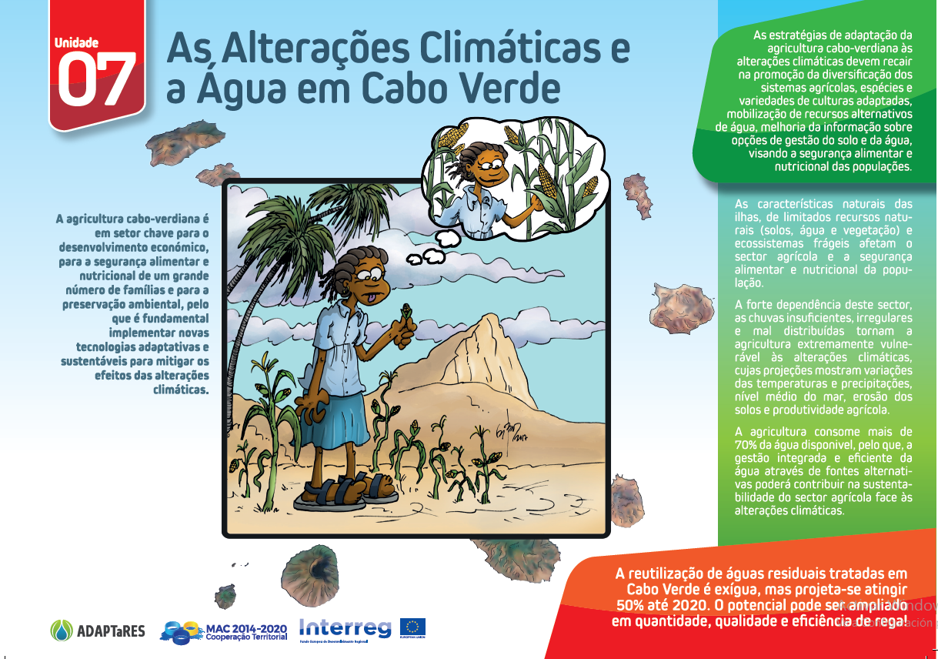
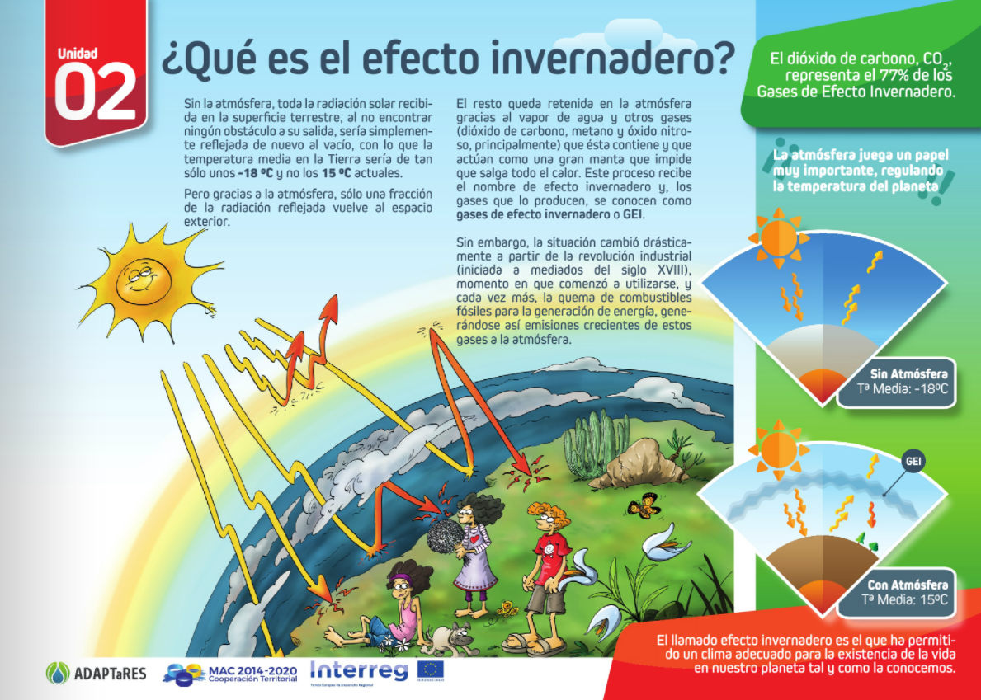
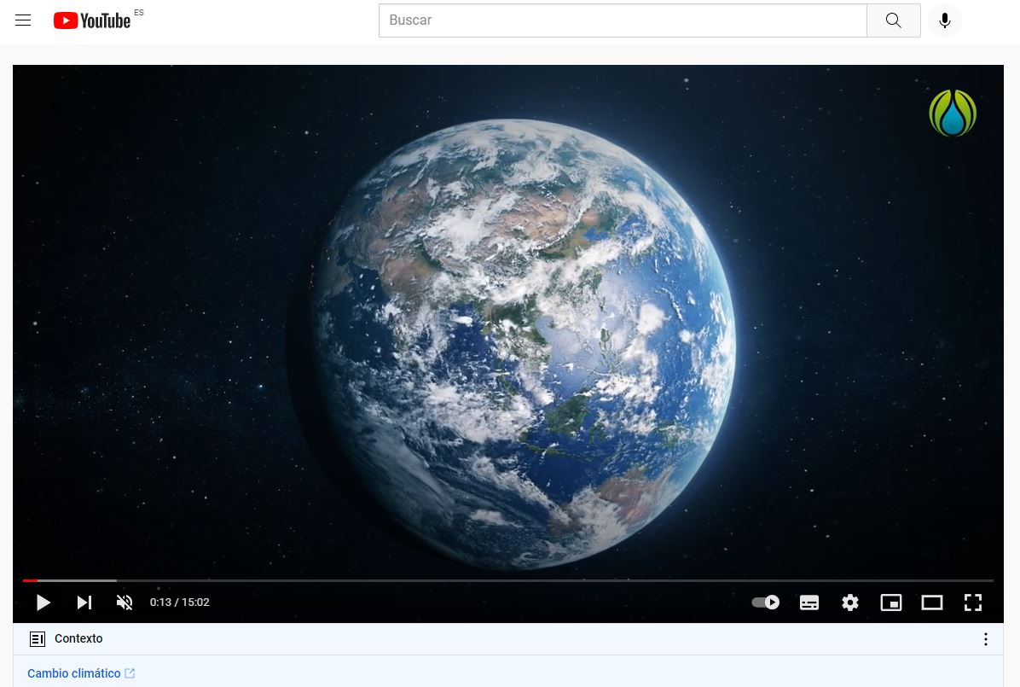
03 Activity 3.3 Awareness-Raising Strategy

Slide 17
1.- Didactic resources generated in the ADAPTaRES project:
Fichas didácticas sobre Adaptación al Cambio Climático (flipbook en español).
Cómic 1: Agua y Cambio Climático. Una vueltita por Madeira y Porto Santo
Cómic 2: Agua y Cambio Climático. Una vueltita por Cabo Verde y Canarias
Campaña de concienciación. ‘Cada gota cuenta. Frente al cambio climático, cambio de hábitos’
Pills awareness campaign: 1 | 2 | 3 | 4 | 5 | 6 | 7
Didactic games on Climate Change and Water: Jugar Descargar
Serie de Animación “Escuela del Agua”. ADAPTaRES Capítulo 1 – Cambio Climático y Agua
Serie de Animación “Escuela del Agua”. ADAPTaRES Capítulo 2 – Agua y Adaptación al Cambio Climático
Serie de Animación “Escuela del Agua”. ADAPTaRES Capítulo 3 – Uso del saneamiento y Reutilización de aguas depuradas
Campaña de concienciación. ‘Cada gota cuenta. Frente al cambio climático, cambio de hábitos’
3.- Sustainable Water Management:
http://www.islhagua.itccanarias.org/flipbooks/comic_es/
4.- Online games: School of Water:
Jugar / Descargar
5.- Animated Series "Water School":
https://youtu.be/BXJDnMyGIQw
https://youtu.be/ehD_pE1_o2g
https://youtu.be/n7YXKhwlEsw
https://youtu.be/MBSYao0J08Y
6.- Didactic Sheets for the Reinforcement of Capacities and Competences related to the Management of Water Resources in Islands:
http://www.islhagua.itccanarias.org/flipbooks/fichas_es/mobile/index.html
03 Activity 3.3 Awareness-Raising Strategy

Slide 18
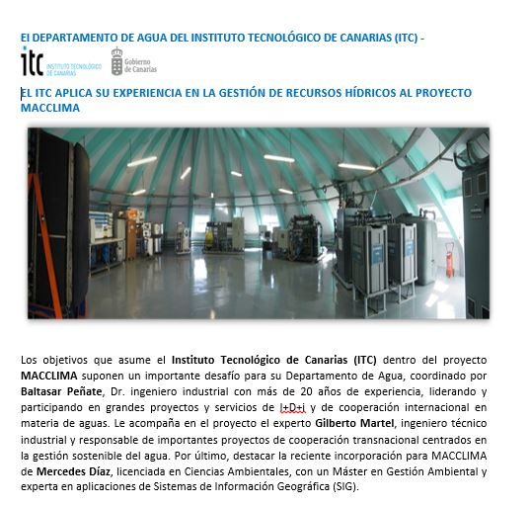
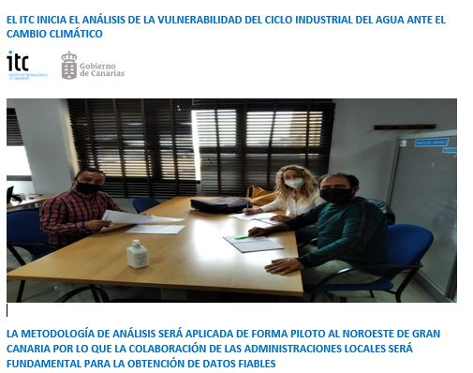
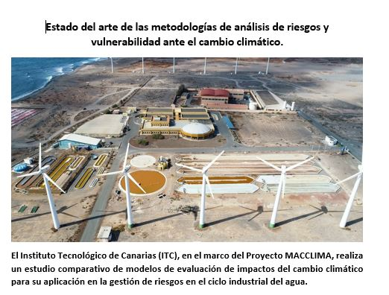
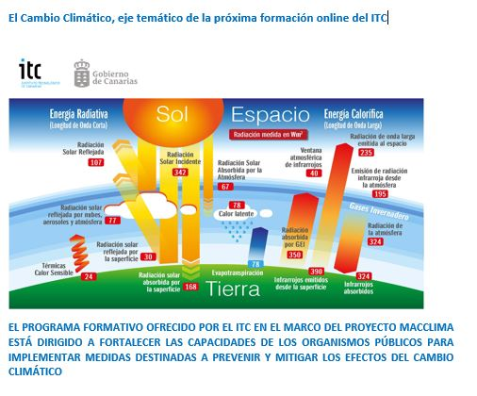
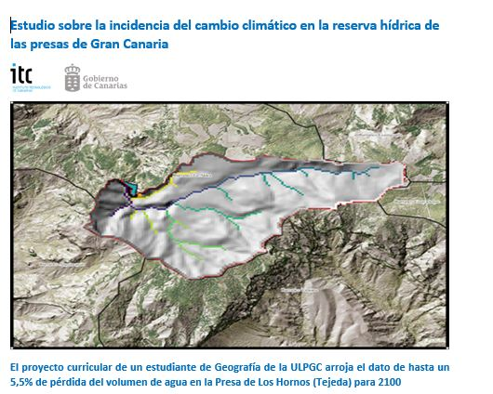
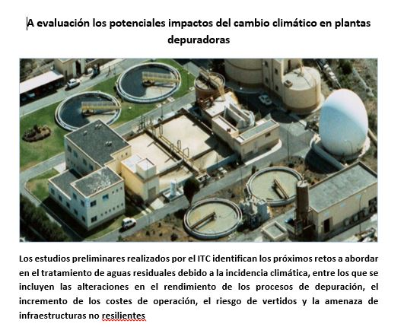
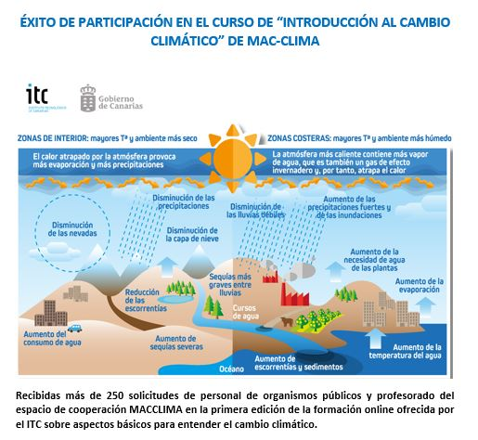
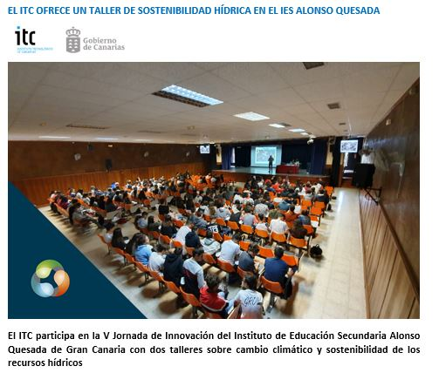
04 Communication
Writing and dissemination of 10 informative articles.

Slide 19
Gracias
Obrigado
Merci Beaucoup
THANK YOU

