Slide 1
Meteorological and Oceanic Observation System as a Tool to Promote Resilience and Adaptation to Climate Change in the Cooperation Space (MAC-CLIMA).
Madeira Island Observational System: LIDAR and Sonic Sensors Campaign
Instrumentation installation, testing, configuration and development to obtain in-situ data
(MAC2/3.5b/254)
1st MAC-CLIMA on-site event
December 1-2, 2021
Las Palmas de Gran Canaria (Spain)
THE 85 PER CENT OF THE PROJECT IS FUNDED BY FEDER FUNDS

Slide 2
INDEX
01
02
Installation
Modus Operandi
03
04
Developed Tools
Present and Future Applications

Slide 3
01
Installation

Slide 4
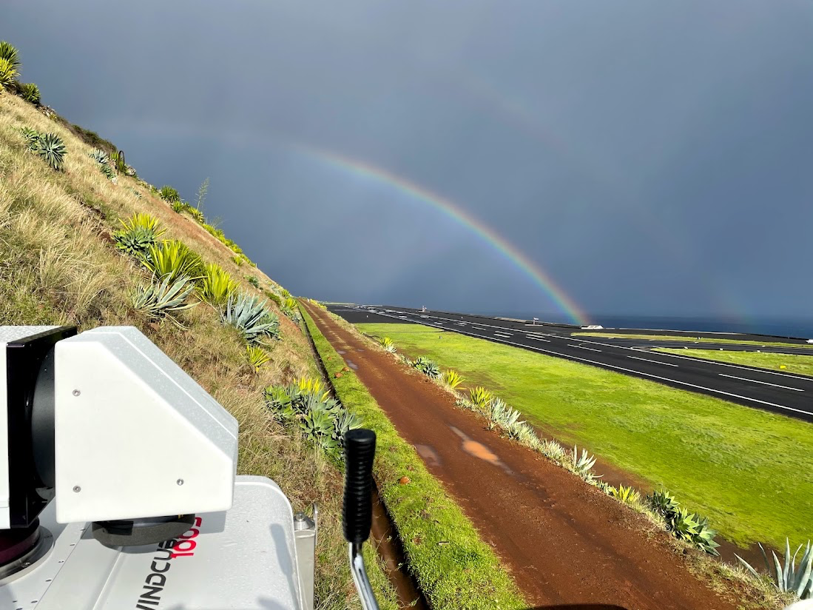
Installation
1,757,54,28€
36
12
The “WindCube 100S” LIDAR is installed by IPMA in a strategic location inside the airport and in operation since December 2020.
The current location allow measure wind flow from the mountains and extreme events that occurs frequently that limit the airport operation.

Slide 5
02
Modus Operandi

Slide 6
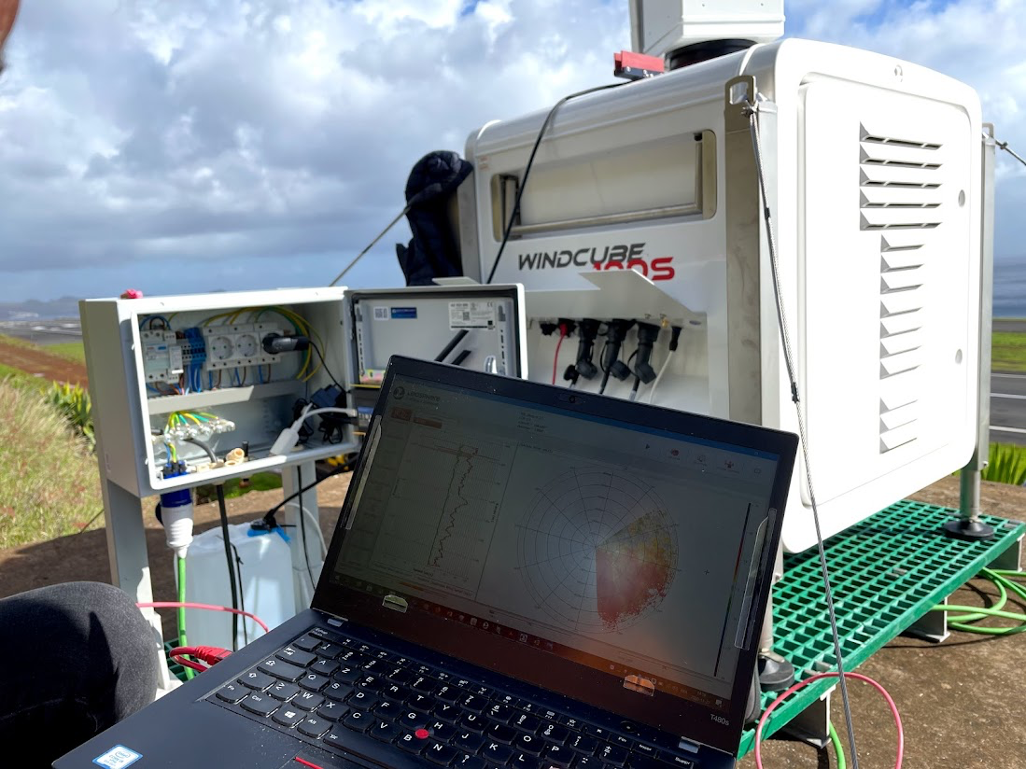
Modus Operandi
1,757,54,28€
36
12
The LIDAR was built on a well-established framework between IPMA and ARDITI.
IPMA is managing the LIDAR connection through their internal network and ARDITI configure the settings and store all the data.
Data is being collected since May of 2021 without interruptions.

Slide 7
03
Developed Tools

Slide 8
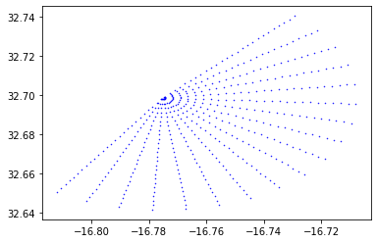
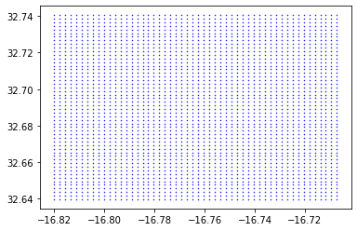
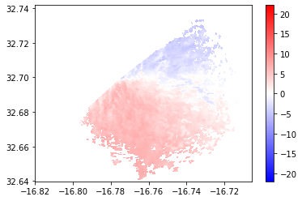
Developed Tools
1,757,54,28€
36
12
LIDAR data pre-processing facilitates the mapping of the radial wind data into a regular grid allowing the model validation and better interpretation.
Scripts to georeferenced, interpolate and transform radial into a regular mesh;
Scripts to transform obtained LIDAR data into a simpler to read format.

Slide 9
04
Present and Future Applications

Slide 10
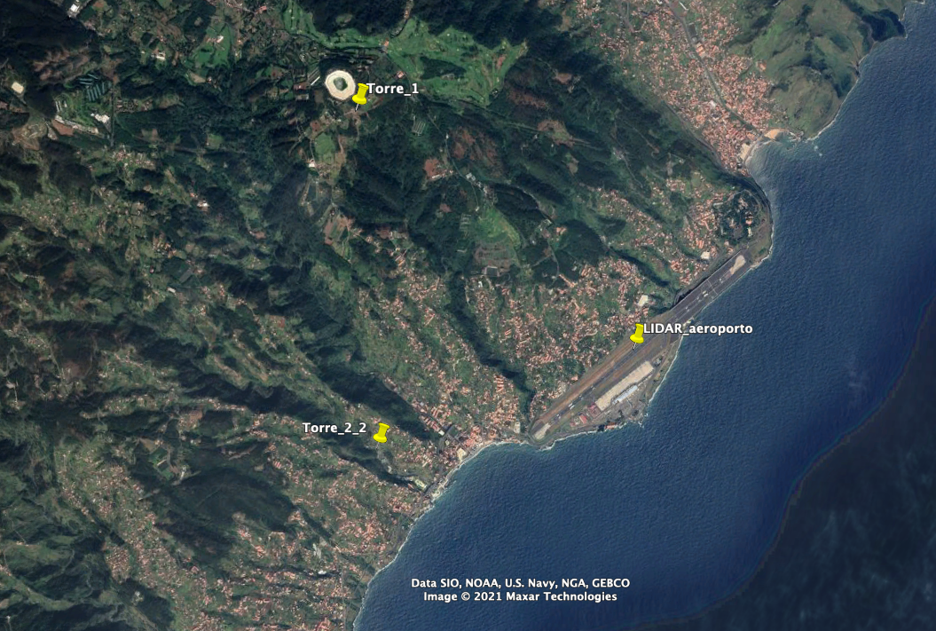
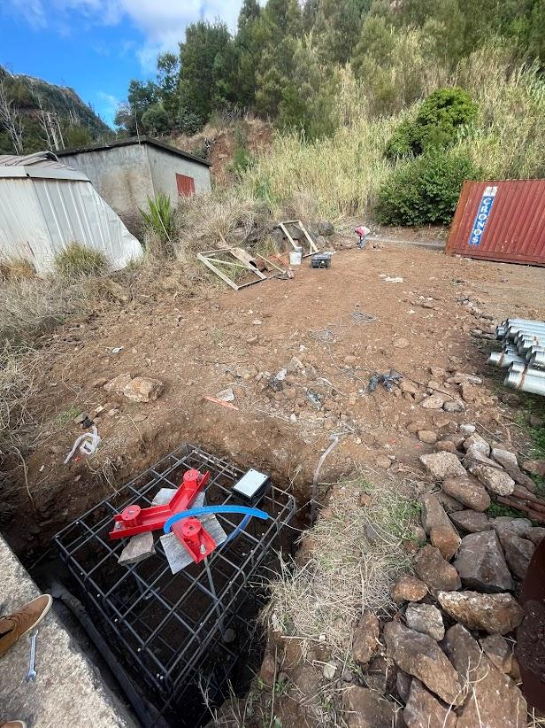
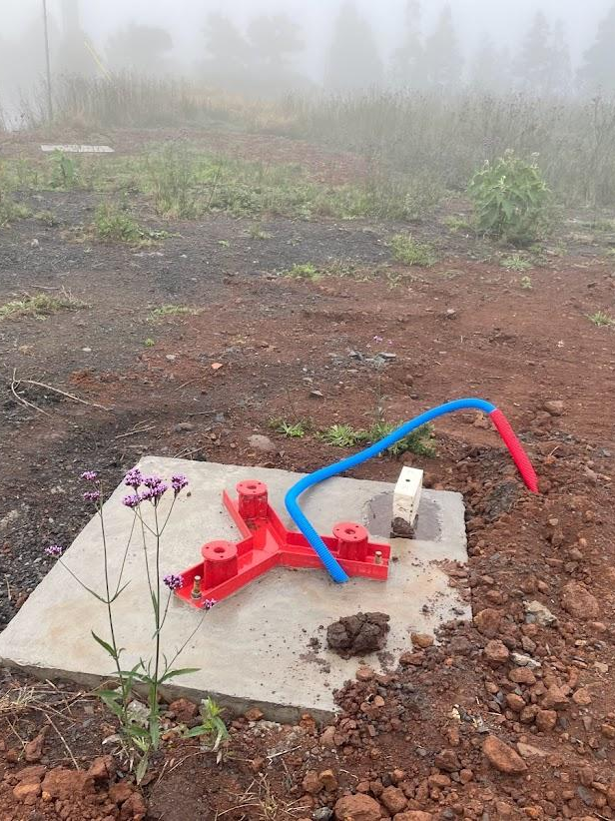
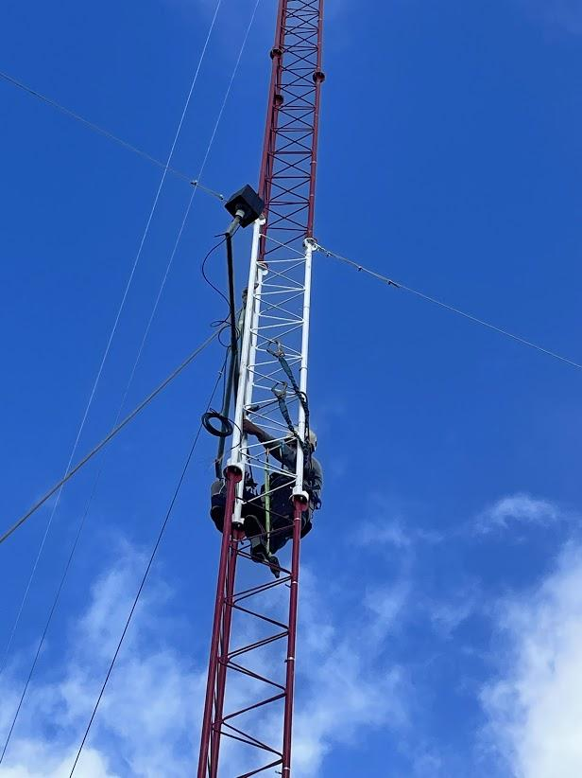
Present and Future Applications
1,757,54,28€
36
12
In the present is being installed masts with sonic sensors at the airport surround area. The purpose is to:
Understand mountainous wind flow;
Complement and compare the LIDAR data;
Validate numerical models with the support of the LIDAR and sonic sensors.

Slide 11
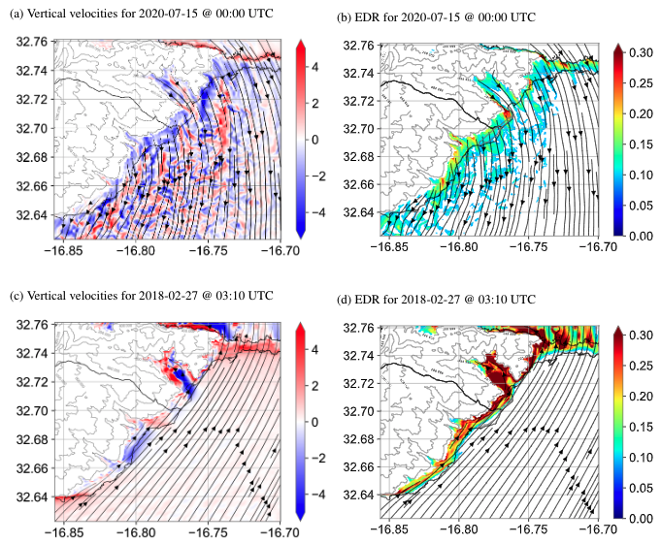
Present and Future Applications
1,757,54,28€
36
12
Study the wind flow and its phenomenon over the airport and the approximation areas by airplane, e and help identify susceptible areas with turbulence and wind shear.
Study sea-breeze cycles and its interactions with the valleys and mountainous regions.
The use of LIDAR and sonic sensors data to validate the numerical models make possible to have a reliable operational tool.

Slide 12
Gracias
Obrigado
Merci Beaucoup
THANK YOU

