Slide 1
Sistema de observación meteorológica y oceánica como herramienta para el fomento de la resiliencia y adaptación al cambio climático en el espacio de cooperación (MAC-CLIMA) AVANCES DEL CABILDO DE TENERIFE
(MAC2/3.5b/254)
1er encuentro presencial MAC-CLIMA
1 y 2 de diciembre de 2021
Las Palmas de Gran Canaria (España)
PROYECTO COFINANCIADO AL 85% POR LA UNIÓN EUROPEA

Slide 2
INDEX
01
Tasks being carried out by Cabildo de Tenerife
02
Next tasks to be carried out by Cabildo de Tenerife

Slide 3
01
Tasks being carried out by Cabildo de Tenerife

Slide 4
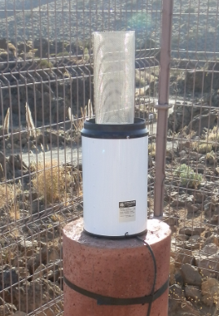
SCIENTIFIC SPECIFIC OBJECTIVE:
Activity 1.2.- Technical and human capacities
Task: Installation of weather monitoring stations and software
Each station to be installed under GCOS standard, consists of the following sensors :
- Temperature and humidity
- Wind speed and direction
- Soil water content sensor (12 cm deep), temperature, conductivity and dielectric permittivity
- Precipitation sensor (pluviometer)
- Short wavelength net radiation sensor (albedometer)
- Ultraviolet B (UVB)
SensorAtmospheric pressure
Another devices:
- Data acquisition system
- Data submission system
- Software for the collection, processing and submission of data

Slide 5
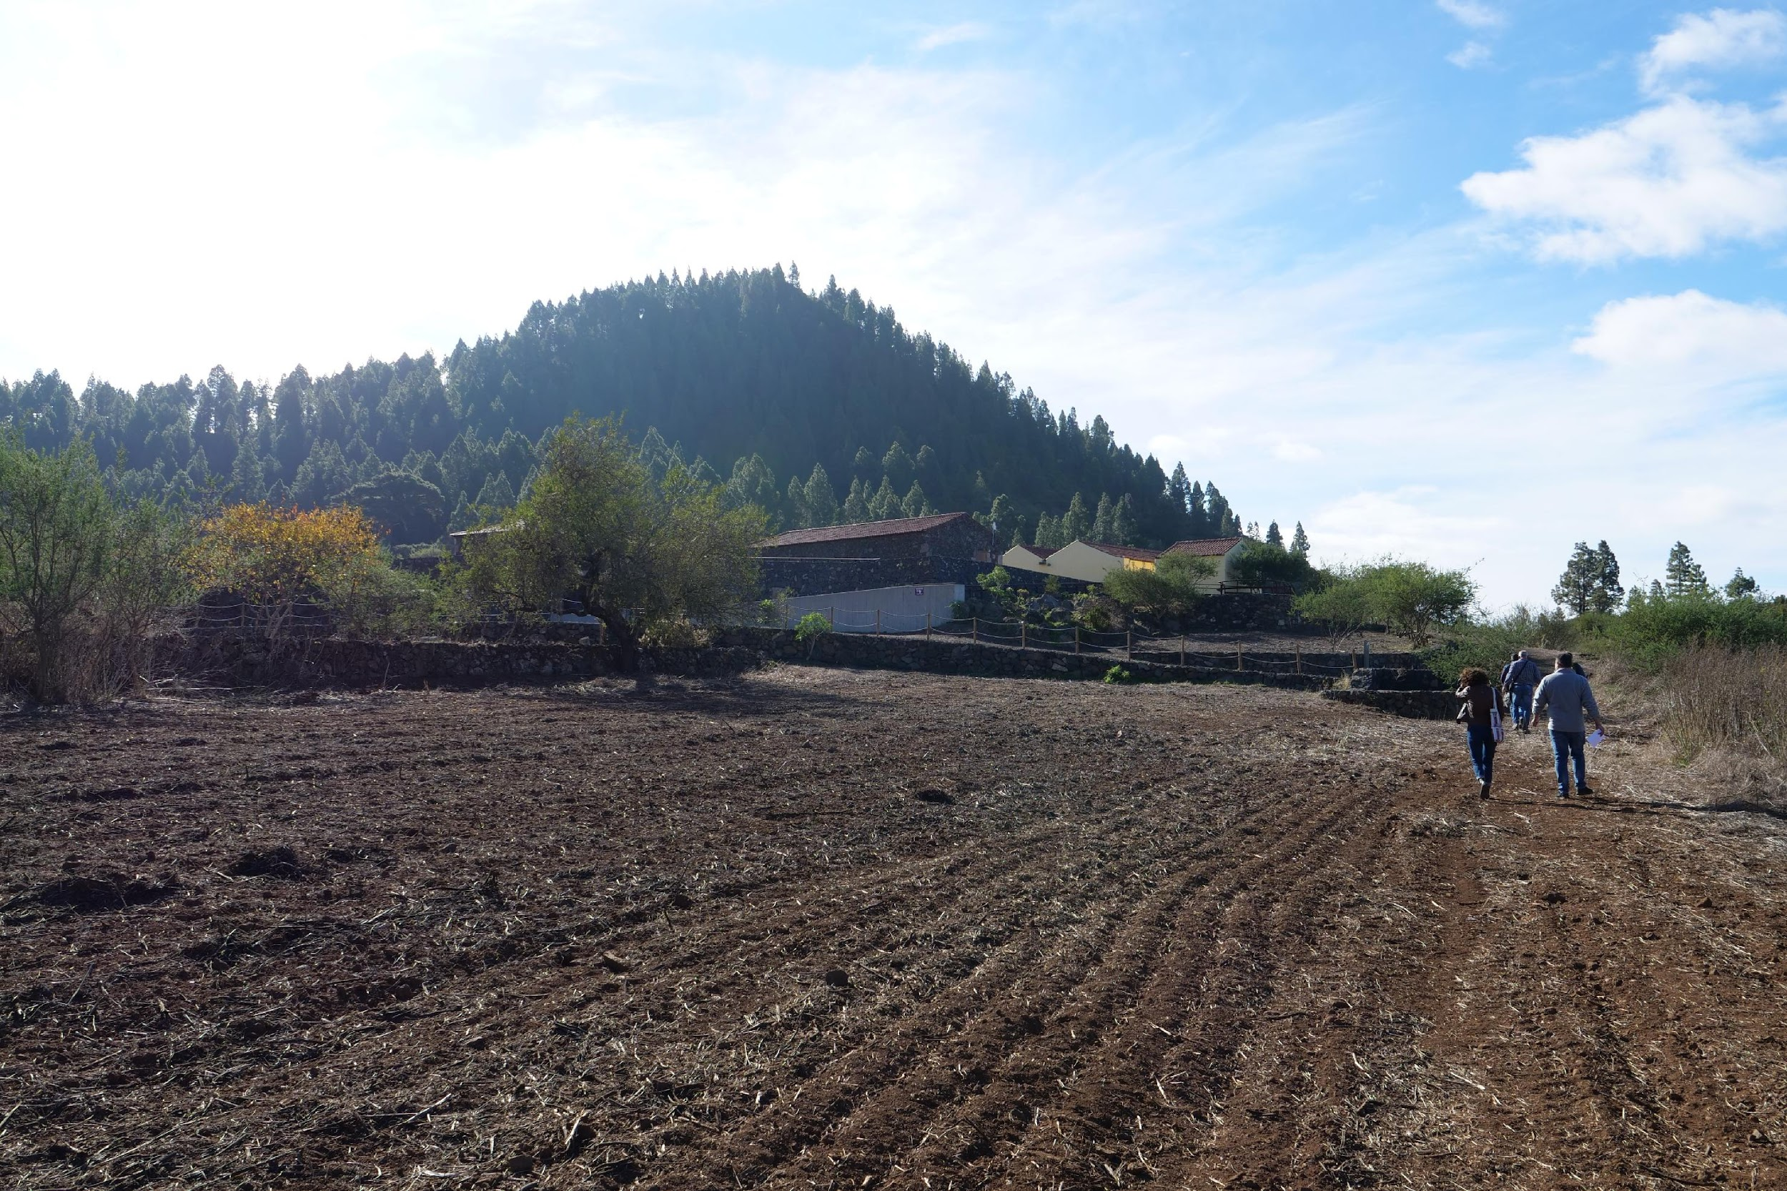
SCIENTIFIC SPECIFIC OBJECTIVE:
Activity 1.2.- Technical and human capacities
Task: Installation of weather monitoring stations and software
Location of the for stations an selection for the place of the first station (Ecomuseo de El Tanque – Parque Rural de Teno)

Slide 6
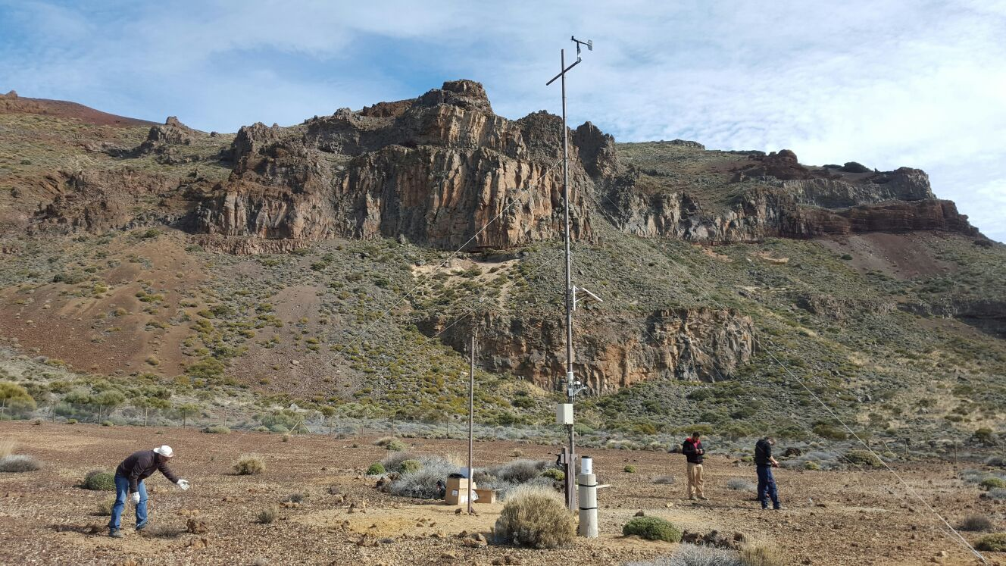
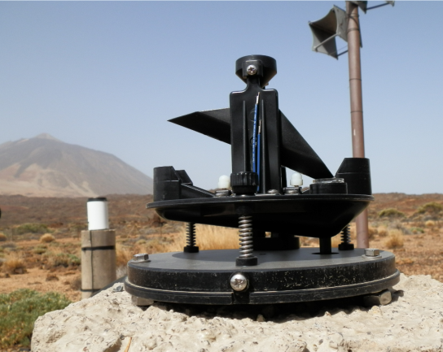
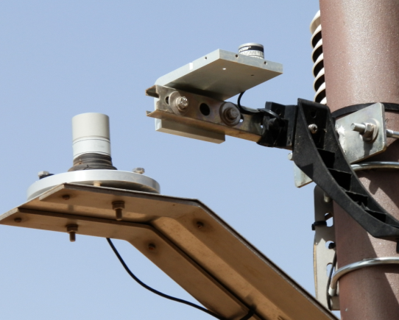
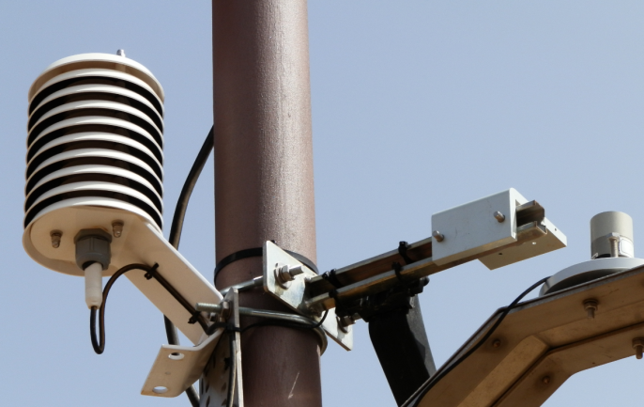
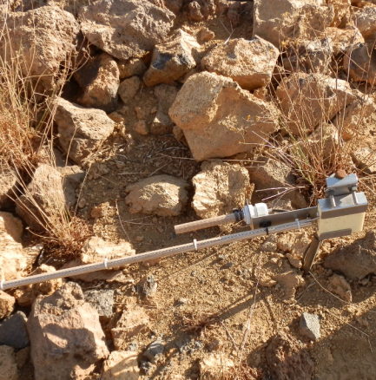
SCIENTIFIC SPECIFIC OBJECTIVE:
Activity 1.2.- Technical and human capacities
Task: Installation of weather monitoring stations and software
An example of a measuring station previously installed in the Teide National Park, with some of its sensors

Slide 7
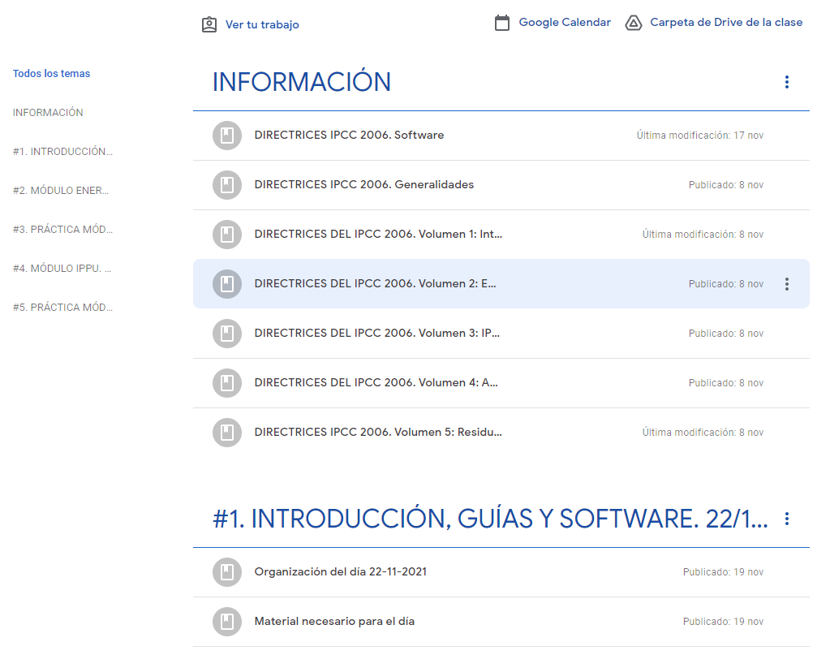
SCIENTIFIC SPECIFIC OBJECTIVE:
Activity 1.2.- Technical and human capacities
Task: Emission inventories training course
TITTLE

Slide 8
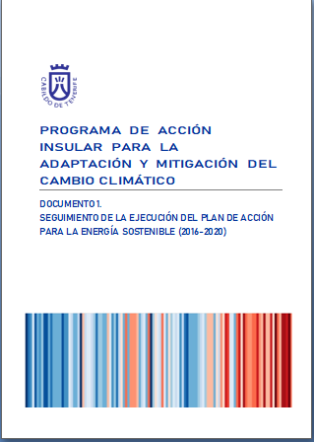
INSTITUTIONAL SPECIFIC OBJECTIVE:
Activity 2.1.- Elaboration of a vulnerability analysis for mitigation and adaptation measures
Task: Contribution with the experience on the Covenant of Mayors
This activity does not have a budget in the Mac-Clima project but the Cabildo wanted to offer collaboration to its partners who would like to know our experience within the Covenant of Mayors of the European Union (as a coordinator and as signatory who has an island’s SECAP)
Although no partner has requested this collaboration, it is noteworthy that next January we will receive a delegation from the municipalities of Praia and Ribeira Grande de Santiago (Cape Verde), who are going to draft a joint SECAP. The delegations will be accompanied by others from Pikine and Dakar (Senegal) and Nouakchott (Mauritania), who wish to draft their own SECAPs too.

Slide 9
SOCIAL SPECIFIC OBJECTIVE:
Activity 3.2.- Awareness and dissemination strategy
Task: Awareness strategy and informative material
Now we are preparing the strategy. The first step has been to carry out a survey with many items common to those of the Cabildo de Gran Canaria.
This survey could have been initially included en the Mac-Clima project (Activity 3.1.) but it has been taken directly by the Cabildo later.

Slide 10
02
Next tasks to be carried out by Cabildo de Tenerife

Slide 11
02 TITTLE
1
Three new weather monitoring stations
2
Practical workshop on emissions inventories: Inventory of greenhouse gases in Tenerife
3
Concluding the awareness and dissemination strategy and informative material

Slide 12
Gracias
Obrigado
Merci Beaucoup
THANK YOU

