Slide 1
Meteorological and Oceanic Observation System as a Tool to Promote Resilience and Adaptation to Climate Change in the Cooperation Space (MAC-CLIMA)
(MAC2/3.5b/254)
1st MAC-CLIMA on-site event
December 1-2, 2021
Las Palmas de Gran Canaria (Spain)
THE 85 PER CENT OF THE PROJECT IS FUNDED BY FEDER FUNDS

Slide 2
INDEX
01
02
03
Tasks to be developed
IRERPA - Regional Inventory of Emissions by Sources and Removal by Sinks of Atmospheric Pollutants
Methodology
04
05
Conclusions
Results
GHG emissions

Slide 3
01
Tasks to be carried out by DRAAC in the MACCLIMA Project

Slide 4
01 Tasks to be developed
Our goals
Specific objectives | Tasks to be developed
1.1.1. | Promotion of institutional cooperation through multilateral meetings: Participation in conferences to be held in each of the territories of the cooperation space
2.2.1. | Seminar for discussion and presentation of SRIERPA results
2.2.2. | SRIERPA -Regional System for Inventory of Emissions by Sources and Removal by Sinks of Atmospheric Pollutants: Production and Publication of IRERPA 2020 (1990-2018) (IRERPA - Regional Inventory of Emissions by Sources and Removal by Sinks of Atmospheric Pollutants)
2.2.3. | Training actions/awareness for the various heads of regional and local public administration
3.3.1. | Survey (Perception study) to the population to know the perception of citizens on the phenomenon of climate change and their vulnerabilities: Data analysis and report production
3.3.2. | Communication and awareness plan in order to improve the level of knowledge of the population about the phenomena of climate change: Training/awareness actions for different target groups (foresters, farmers, teachers, journalists and other citizens)
1,757,54,28€
36
12
Executed
Ongoing
Due to the pandemic, the Meeting in Madeira?
Deferred to 2022
due to pandemic
In the process of being awarded
Delayed due to pandemic

Slide 5
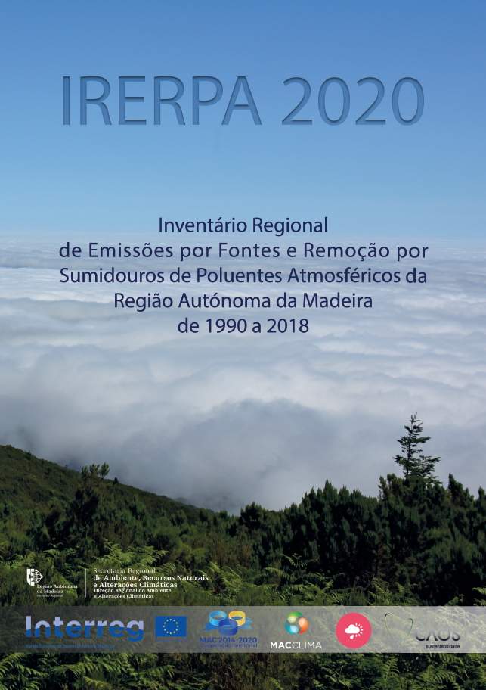
02
Regional Inventory of Emissions by Sources and Removal by Sinks of Atmospheric Pollutants
IRERPA 2020 (1990-2018)

Slide 6
02 IRERPA objectives
Climate Policy Tool in RAM
The main objective of the Inventory is to obtain reliable data and contribute to the knowledge of the annual balance between emissions and removal of greenhouse gases (GHG), covering anthropic activities that emit greenhouse gases or remove pollutants from the atmosphere in the territory, fundamental information to support the climate policy of the region in the mitigation and adaptation components
1
Calculate and set reduction targets
2
Estimate the efforts needed to reduce emissions
3
Monitor and verify compliance with established targets

Slide 7
03 Methodology
03
General Methodology Used in The Preparation of IRERPA

Slide 8
Methodology - Continuation
AÑO 2020
AÑO 2021
AÑO 2022
The IRERPA report follows the structure and methodologies set out in the 2006 Intergovernmental Panel on Climate Change Guidelines (IPCC 2006).
These are the guidelines to which the signatory countries of the United Nations Framework Convention on Climate Change (UNFCCC), the Kyoto Protocol (KP) and the Paris Agreement (PA) are obliged and that guarantee the comparability and quality of the information reported.
This choice thus has the objective of producing information comparable to that produced in other geographies and facilitating the preparation of information submitted by the country as a whole in its National Inventory of Emissions, prepared by the Portuguese Environment Agency and which follows the same guidelines.
General Approach to Emissions Calculation
The Emissions Calculation follows a relatively simple general methodology that can be summarized in Figure
Illustration of the Calculation of Emissions

Slide 9
Methodology - Continuation
AÑO 2020
AÑO 2021
AÑO 2022
Activity data refer to activities in the various sectors that give rise to emissions (eg diesel consumption; tonnes of fertilizer used; burned hectares), while emission factors refer to the amounts of different gases emitted by various activities. Both activity data and emission factors naturally vary from sector to sector, but they also vary with the greenhouse gas considered and the methodological level adopted for each emission category.
Greenhouse Gases and Global Warming Potentials
There are several greenhouse gases considered by the IPCC 2006.
IRERPA uses the Global Warming Potentials (GWP) in effect for reporting emissions by Developed Countries under the UNFCCC. GWPs are used to convert the emissions of various greenhouse gases into an equivalent carbon dioxide emission

Slide 10
Methodology - Continuation
AÑO 2020
AÑO 2021
AÑO 2022
Greenhouse Gases and Global Warming Potentials
Gás de Efeito de Estufa |  | PAG (tCO_{2eq})
Dióxido de Carbono | CO₂ | 1
Metano | CH₄ | 25
Óxido Nitroso | N₂O | 298
Hidrofluorcarbonos | HFCs | variável por gás
Perfluorcarbonos | PFCs | variável por gás
Hexaflureto de Enxofre | SF₆ | 22 800
Trifluoreto de Azoto | NF₃ | 17 200
Trufuorometil sulfur pentafluoreto | SF₅CF₃ | 17 700
Éteres halogenados |  | variável por gás
Outros Halocarbonos não cobertos pelo Protocolo de Montreal |  | variável por gás
The gases referenced with a gray color were not calculated for the estimation of emissions in this version of IRERPA, because it was not possible to obtain the respective information.

Slide 11
Methodology - Continuation
AÑO 2020
AÑO 2021
AÑO 2022
Information Structure
Report
Excel Tables
Regional Emissions Inventory
Cap 0 Emissions Summary
Cap 1 Energy
Cap 2 Industrial Processes and Product Usage
Cap 3 Agriculture
Cap 4 Land Use and Forests
Cap 5 Waste

Slide 12
04
Results
GHG emissions

Slide 13
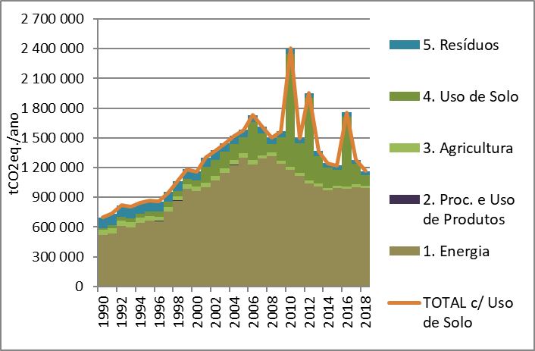
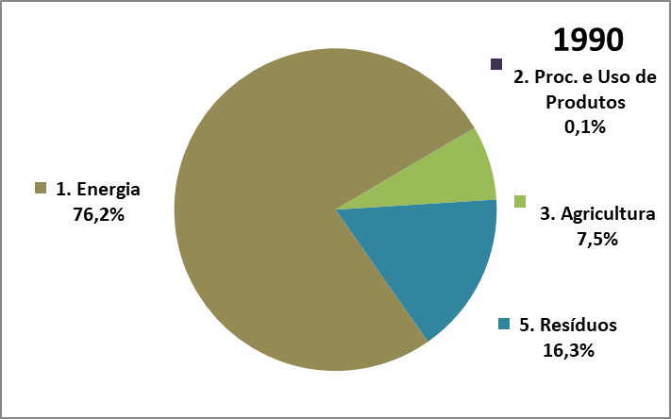
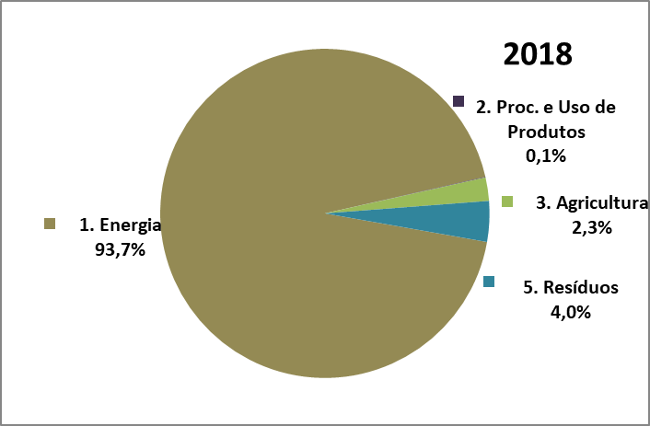
04 Results GHG Emissions
Results GHG emissions
Results – GHG Emissions, 1990-2018
Acordo de Paris
GHG Emissions without Land Use:
1,06 MtCO2eq. in 2018
1.4% reduction between 2017 and 2018
25.4% reduction between 2005 and 2018
54.9% increase between 1990 and 2018
GHG Emissions with Land Use:
1,20 MtCO2eq. in 2018
9% reduction between 2017 and 2018
26.5% reduction between 2005 and 2018
66,7% increase between 1990 and 2018

Slide 14
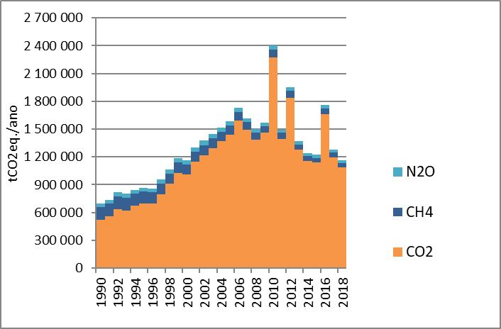
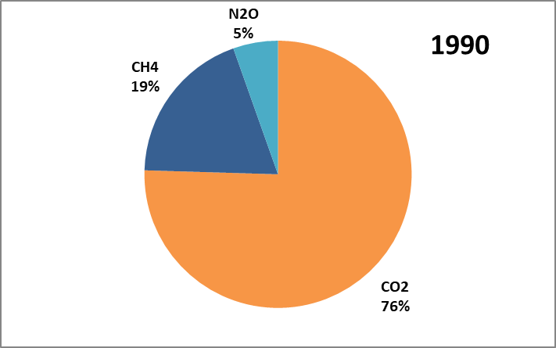
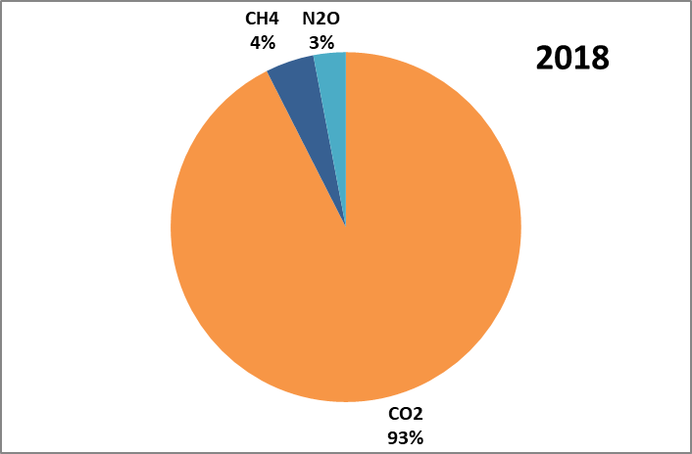
Results GHG Emissions
Results GHG emissions
Results – GHG Emissions, 1990-2018

Slide 15
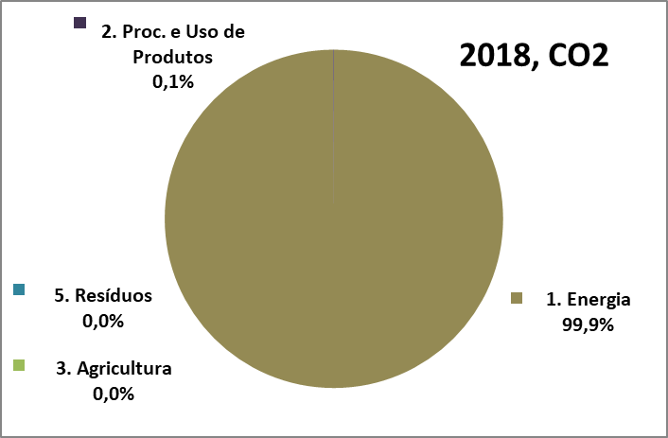
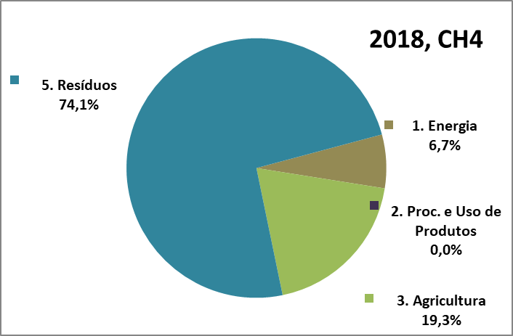
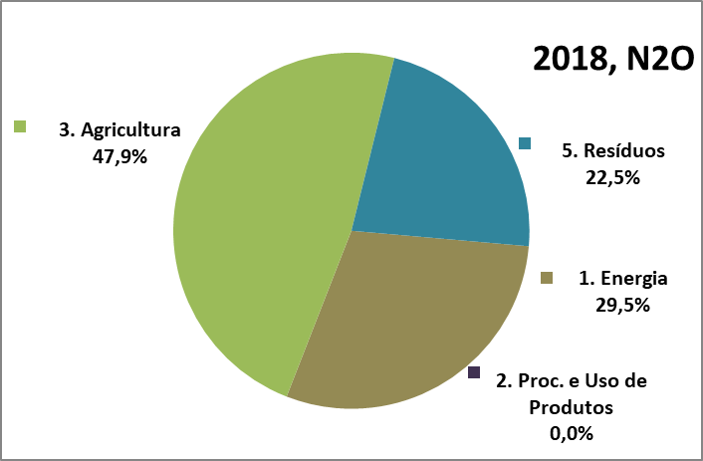
Results GHG Emissions
Results GHG emissions
Results - Main GHG Emissions

Slide 16
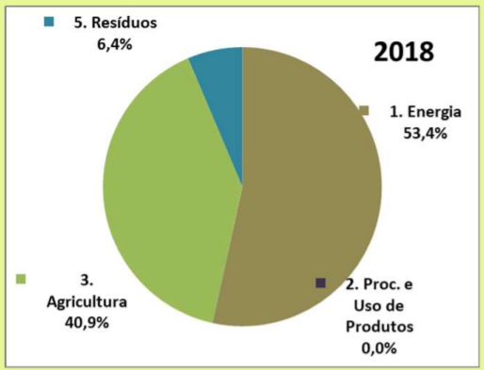
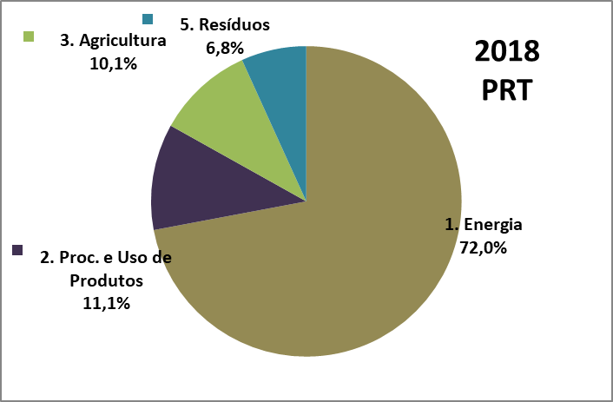
Results GHG emissions
Results – Profile of Emissions in the different territories of Portugal
Madeira
Açores

Slide 17
Results GHG emissions
Results - Carbon Intensity
 | GDP 2018 | Population | Emissions 2018
 | mil € | habitantes | tCO2
Portugal | 203 896 177 | 10 276 617 | 60 993 000
Madeira | 4 890 858 | 253 945 | 1 162 935
 | 2,4% | 2,5% | 1,9%
 | Carbon Intensity of GDP | Per capita emissions
 | tCO2 / M€ | tCO2 / habitante
UE 27 | 279 | 7,0
Portugal | 299 | 5,9
Madeira | 238 | 4,6
 | -15% UE -20% PT | -34% UE -23% PT
Source: INE, IRERPA

Slide 18
05
Conclusions

Slide 19
05 Conclusions
Paris Agreement
Portugal intends to ensure a sustainable trajectory of reduction of GHG emissions in order to reach, in relation to 2005, a target of -18% to -23% in 2020 and of -30% to -40% in 2030.
Between 2005 and 2018, RAM had a reduction of:
25.4% of GHG emissions (not considering Land Use).
26.5% of GHG emissions (considering Land Use).
The Energy sector is the main source of GHG emissions, where mitigation policies will have to focus.
In RAM, the emission reduction trend is in line with the Paris Agreement objectives.

Slide 20
Gracias
Obrigado
Merci Beaucoup
THANK YOU

