Slide 1


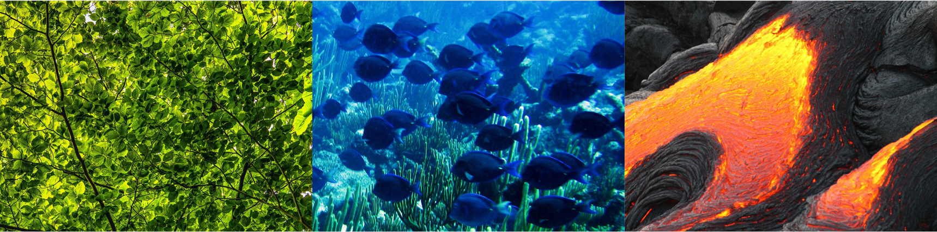
Meteorological and oceanic observation system in Mauritania as a tool for promoting resilience and adaptation to climate change in the cooperation space (MAC-CLIMA )
(MAC2/3.5b/254)
1st Mac-Climate Face-to-Face meeting 1 et 2 décembre 2021
Las Palmas de Gran Canaria (Espagne)
PROYECTO COFINANCIADO AL 85% POR LA UNIÓN EUROPEA

Slide 2

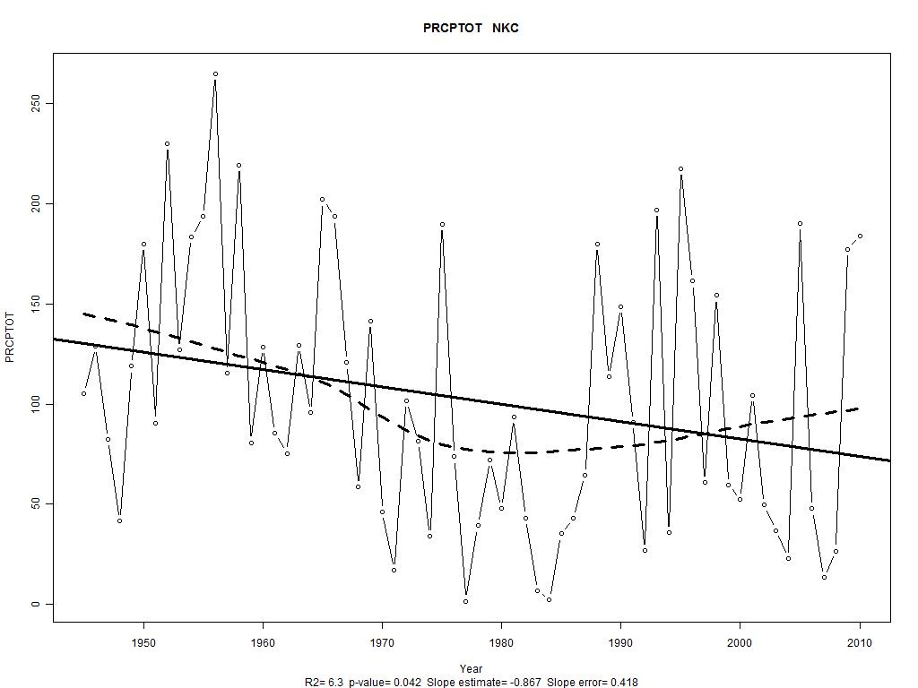
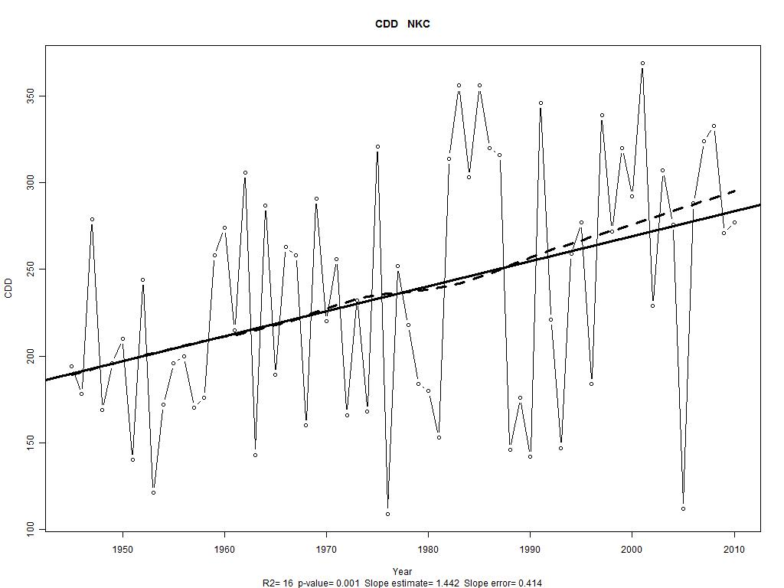
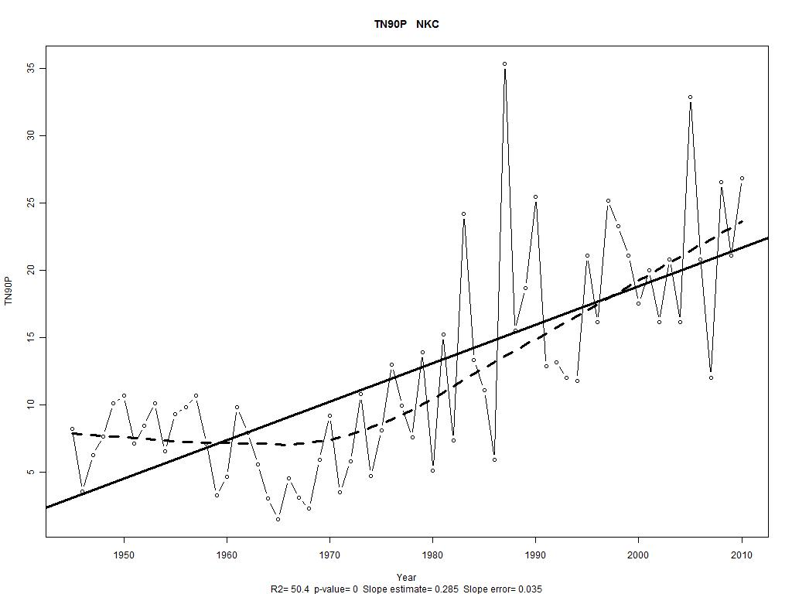
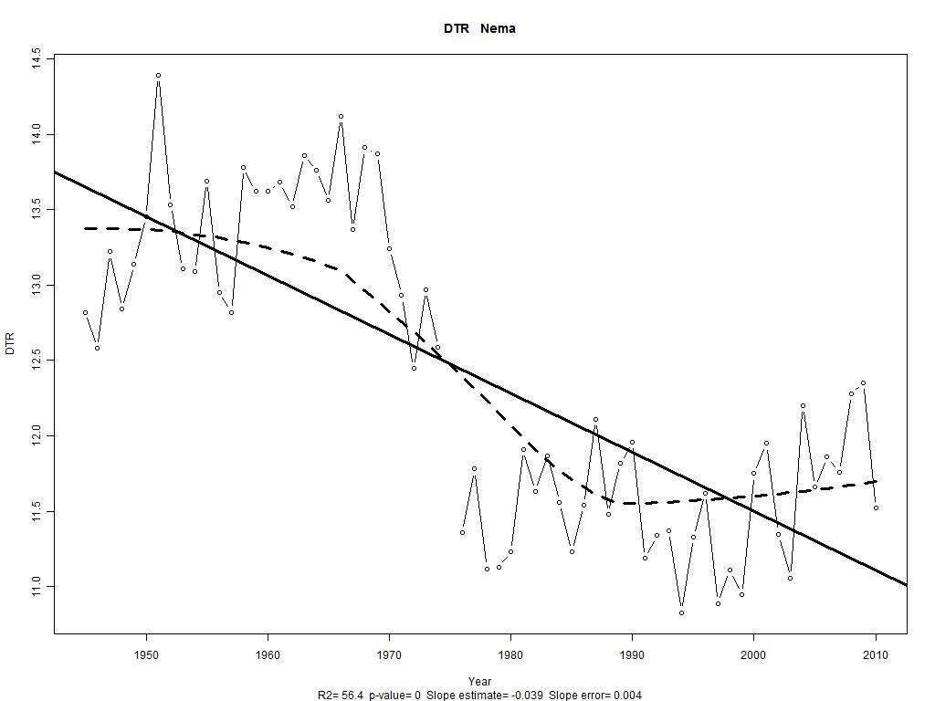
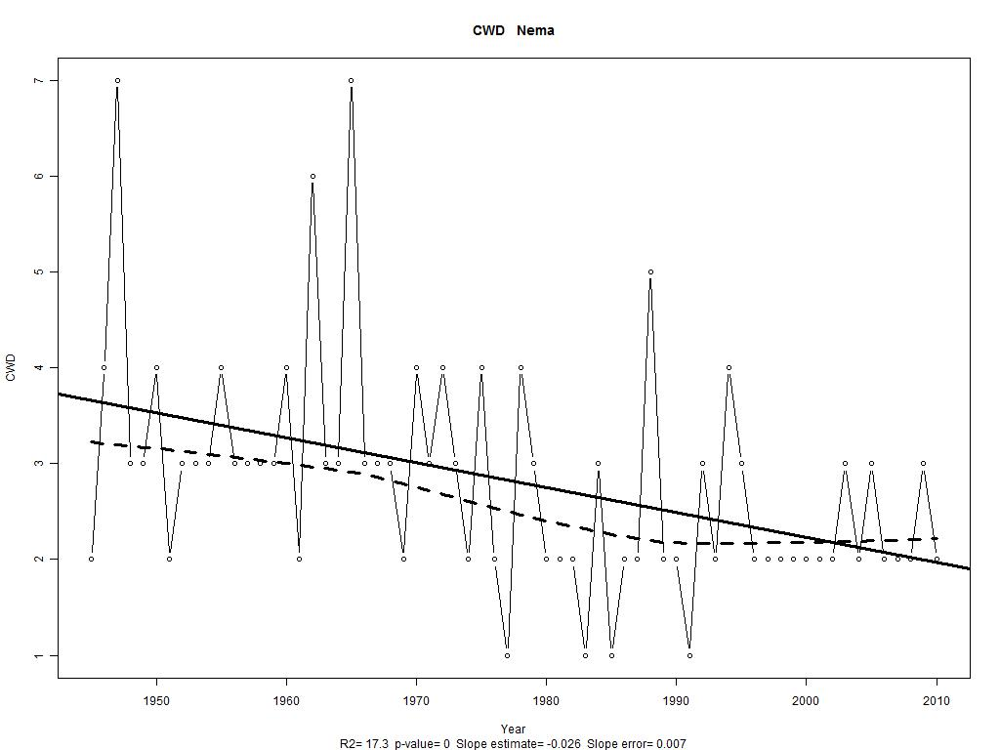
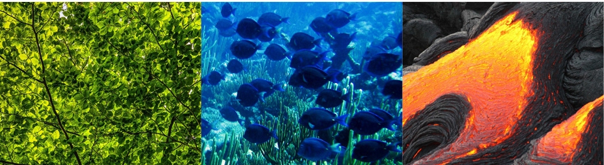
Climatic indices in Nouakchott
Decrease of the total precipitation ( PRCPTOT);
Increase in the consecutive dry days (CDD);
Increase in the warm nights (TN90P);
the same trends are observed on all synoptic stations
Decrease in the difference between the monthly average TX et TN (DTR);
Decrease in the consecutive wet days (CWD)

Slide 3
01
RCP scénario for
Mauritania

Slide 4
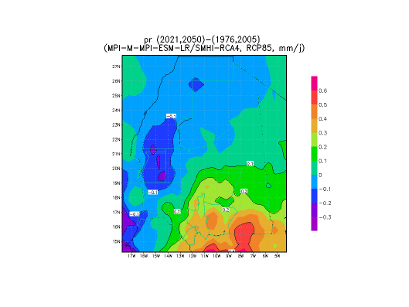
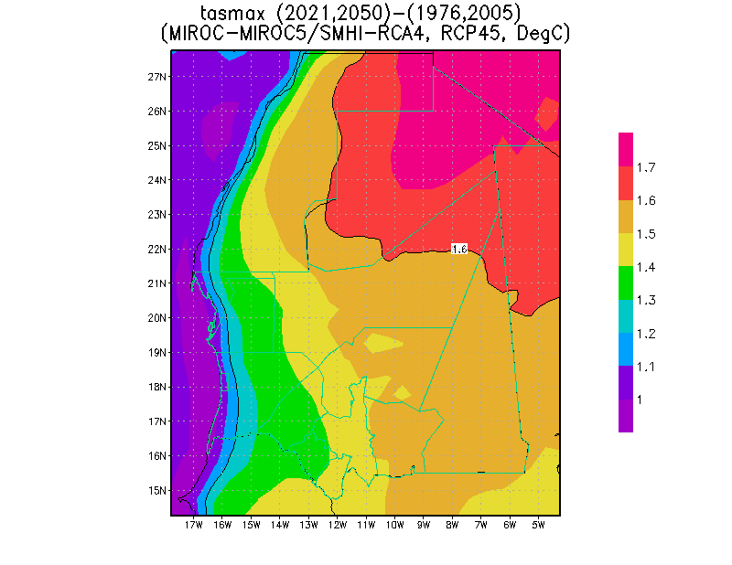
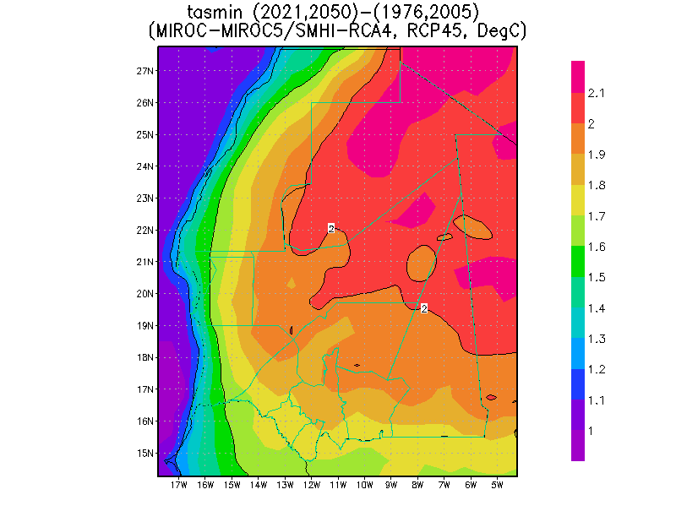
Scénario for Mauritania
1,757,54,28€
36
12
The different scenarios are inanimate for an increase in temperatures;
the results for precipitation differ according to the different scenarios.

Slide 5
02
Improve product quality for better resilience and adaptation to climate change and adaptation to climate change

Slide 6
02 Improve product quality
The main objectives
1
Rehabilitation and densification of the meteorological and oceanic observation network: (03 agro-meteorological stations have already been installed and two maritime stations being acquired for the ports of NKC and N’Diago; three coastal stations acquired by the MarinMet project are to be rehabilitated over the next month);
2
Exchange with different users (farmers, breeders, fishermen, etc.) to better take into account their needs in the development of products;
3
Wide dissemination of specific products using media, social media and roving seminars

Slide 7
2.1 Continuous training
2.1
Continuous training of technical staff

Slide 8
AÑO 2020
AÑO 2021
AÑO 2022
Improving the quality of data and products requiers continuous training for:
- Observers;
- Forecasters;
- Climatologists;
- Maintenance technicians.
We count a lot on the participation of the MACCLIMA project in the realization of these activities

Slide 9
Improving data and products requires training in the following areas :
AÑO 2020
AÑO 2021
AÑO 2022
- Observation codes;
- Analysis of satellite images;
- Marine meteorology;
- Forecasting tools;
- Data processing tools;
- Database management;
- Climate change and scénario
- Monitoring and maintenance
of automatic stations.
We count a lot on the participation of the MACCLIMA project in the realization of these activities

Slide 10
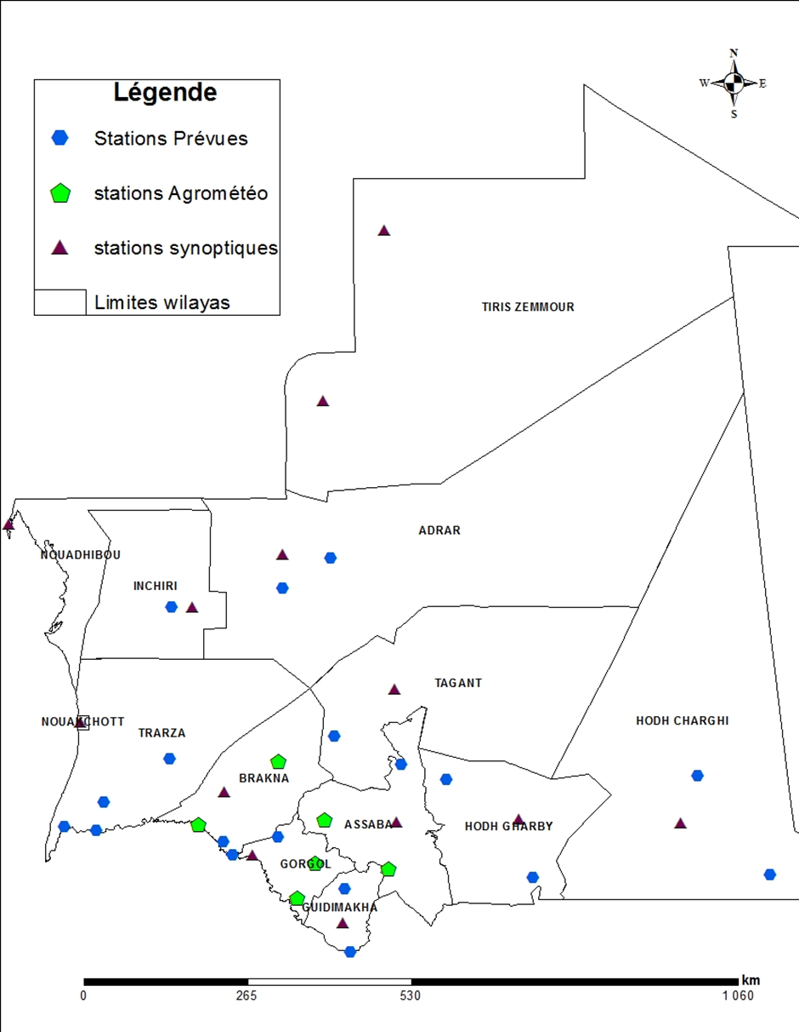
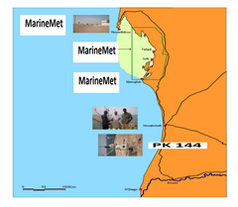
03 Current network
Current meteorological and ocean observation network
- 15 Synoptic stations;
- 11 Agro-meteorological stations;
- 03 Costal stations;
- More than 200 pluviometric post;
- 3 Marine stations out of service;

Slide 11
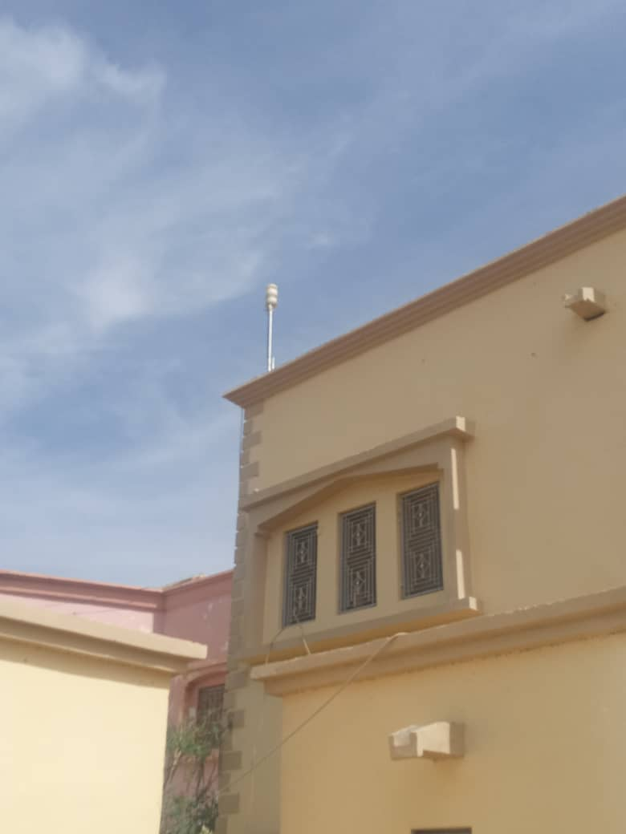
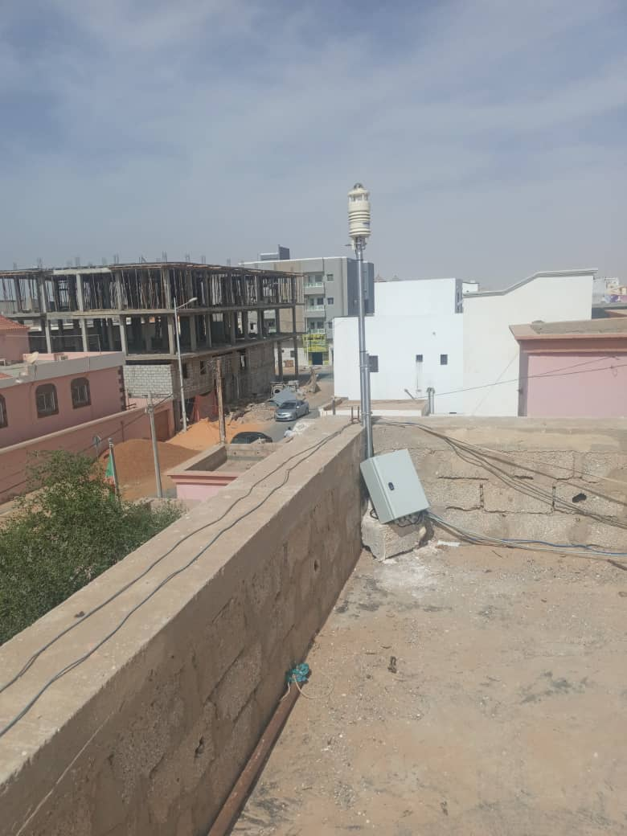
03 Current network
Current meteorological and ocean observation network
Station offered by AEMET as part of Mac-Clima, it measures weather parameters and size of dust and sand particles (PM10). It can strengthen collaboration in the field of health and climate research,

Slide 12
04
Products for decision making and risk reduction

Slide 13
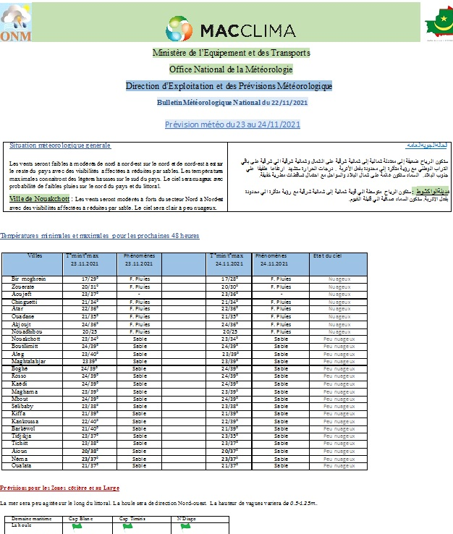
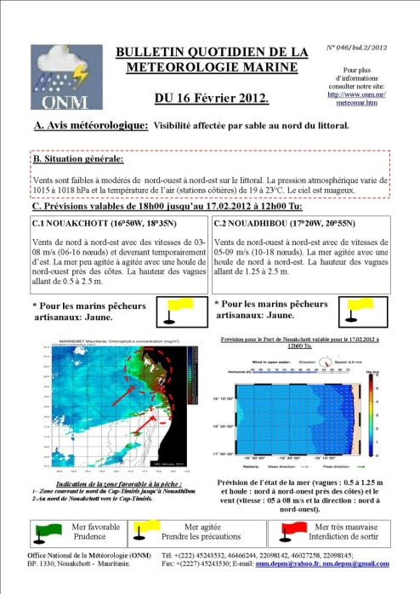
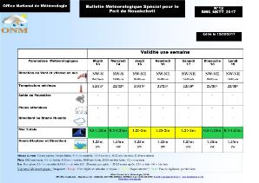
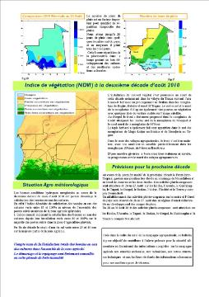
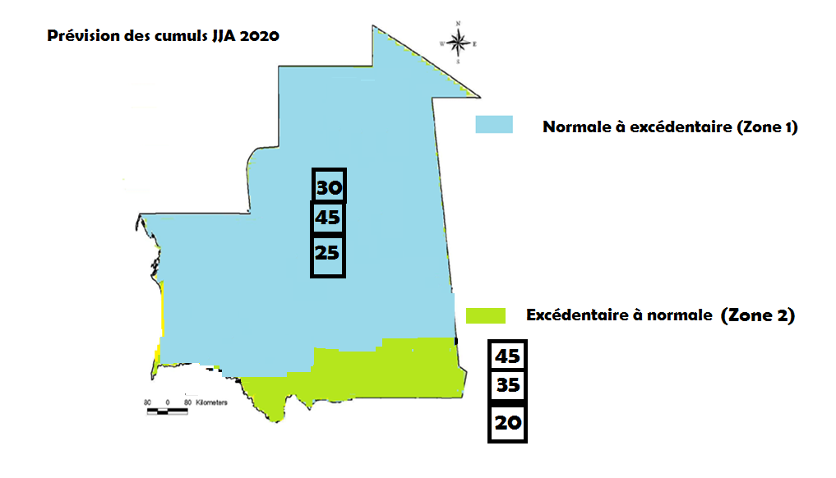
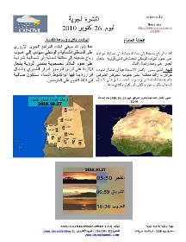
04 Different Products

Slide 14
Gracias
Obrigado
Merci Beaucoup
THANK YOU

