Slide 1
Meteorological and Oceanic Observation System as a Tool to Promote Resilience and Adaptation to Climate Change in the Cooperation Space (MAC-CLIMA)
(MAC2/3.5b/254)
1st MAC-CLIMA on-site event
December 1-2, 2021
Las Palmas de Gran Canaria (Spain)
THE 85 PER CENT OF THE PROJECT IS FUNDED BY FEDER FUNDS

Slide 2
INDEX
01
02
IOCAG
TIDES

Slide 3
01
IOCAG

Slide 4
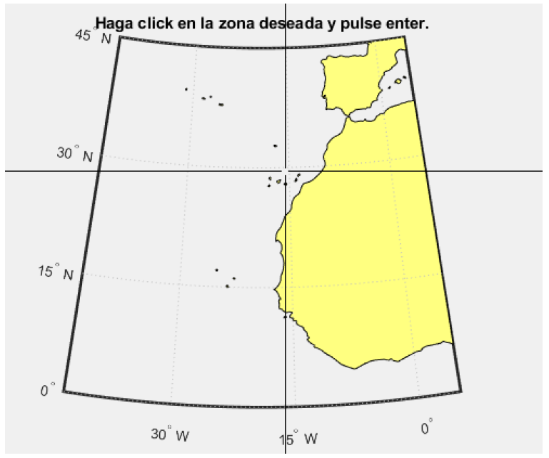
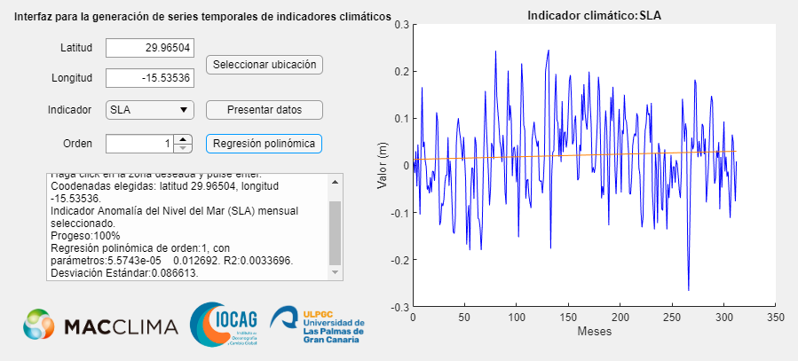
RESULTS IMAGE PROCESSING AND REMOTE SENSING GROUP (IOCAG-ULPGC)
IMPLEMENTATION OF A CLIMATE CHANGES (CC) SERIES GUI, SPECIFICALLY 4 PARAMETERS, OBTAINED FROM LOW/MEDIUM RESOLUTION SATELLITES DATA::
Sea Level Anomaly (SLA)
Sea Surface Temperature (SST)
Atmospheric Optical Thickness 550 nm (AOT)
Chlorophyll-A (CHL)
1,757,54,28€
12

Slide 5
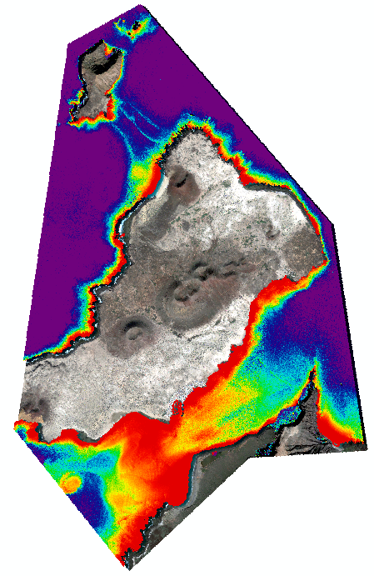
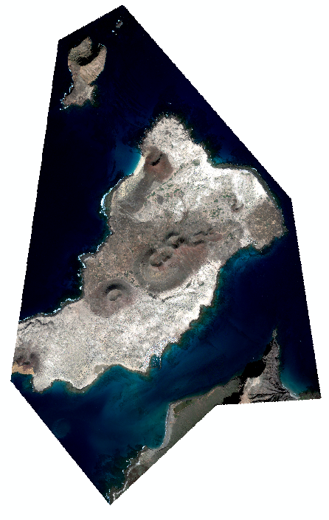
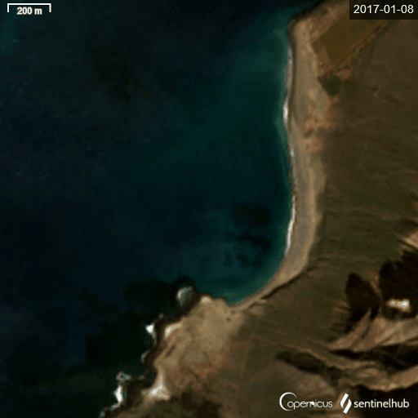
RESULTS IMAGE PROCESSING AND REMOTE SENSING GROUP (IOCAG-ULPGC)
DEVELOPMENT OF A HIGH RESOLUTION SATELLITE (WORLDVIEW SERIES) IMAGE PROCESSING PROCEDURE FOR OBTAINING:
Bathymetry Maps.
Benthic Habitats Maps
FUTURE WORKS (2022):
1.- SATELLITE MULTITEMPORAL ANALYSIS OF BATHYMETRY AND BOTTOM TYPES.
2.- HIGH RESOLUTION MULTIPLATFORM (SATELLITE AND DRONE) PROCESSING OF 2 LITTORAL ZONES.
1,757,54,28€
12
LA GRACIOSA ISLAND (CANARY ISLAND)
Bathymetry Map
WV2 17 December 2015
SENTINEL-3

Slide 6
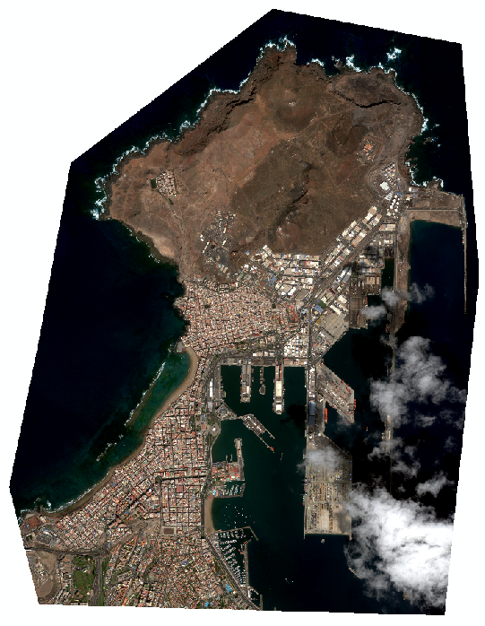
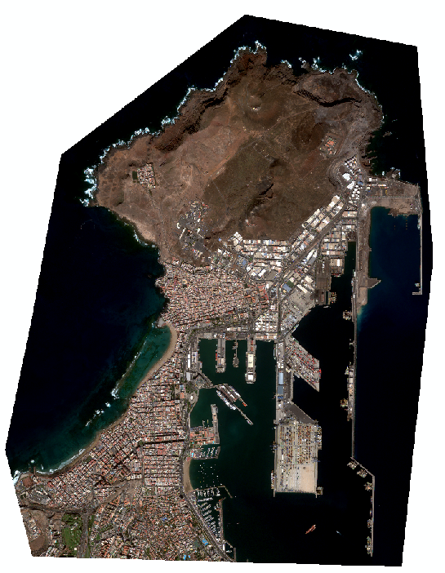
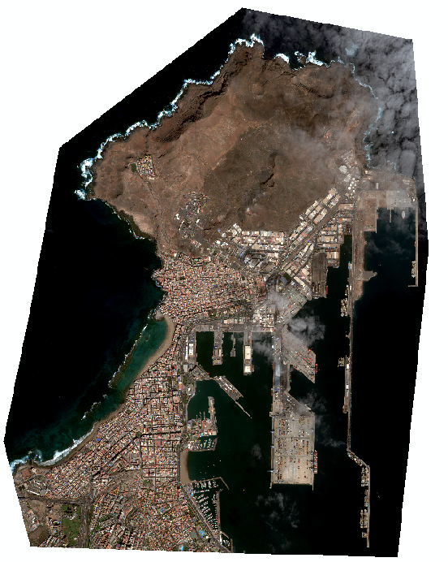
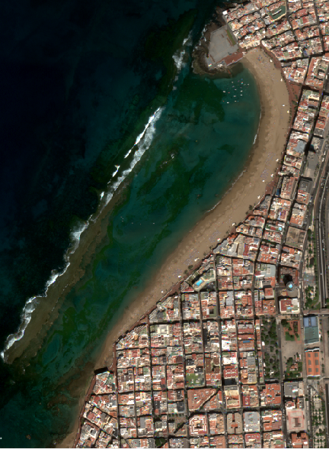
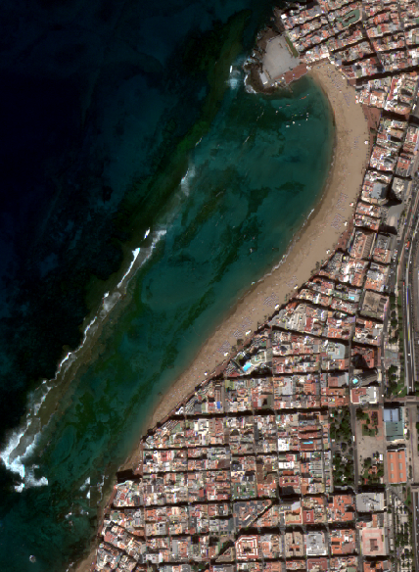
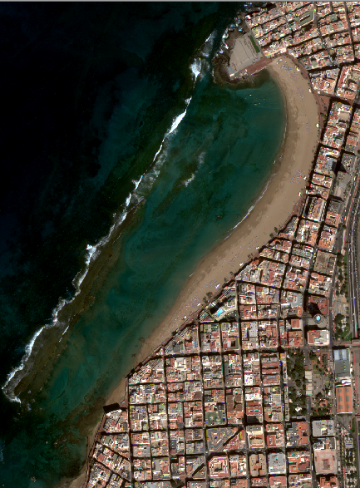
RESULTS IMAGE PROCESSING AND REMOTE SENSING GROUP (IOCAG-ULPGC)
SATELLITE MULTITEMPORAL ANALYSIS OF BATHYMETRY AND BOTTOM TYPES
1,757,54,28€
12
WV2 14 october 2014
WV2 18 october 2016
WV3 28 february 2020

Slide 7
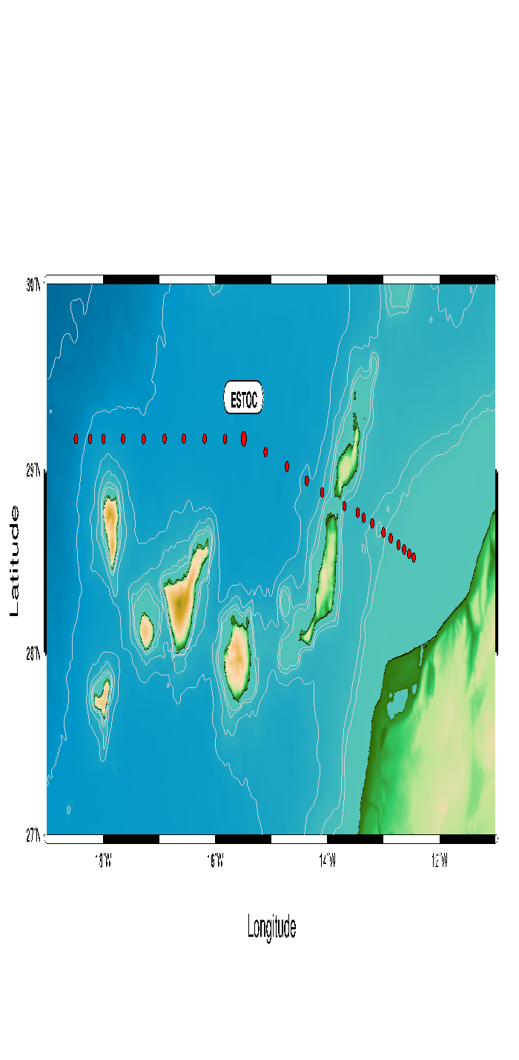
RESULTS PHYSICAL OCEANOGRAPHIC GROUP (IOCAG-ULPGC)
1,757,54,28€
12
An increase of Temperature means a sea level high
An increase of salinity means, probably, less precipitation.

Slide 8
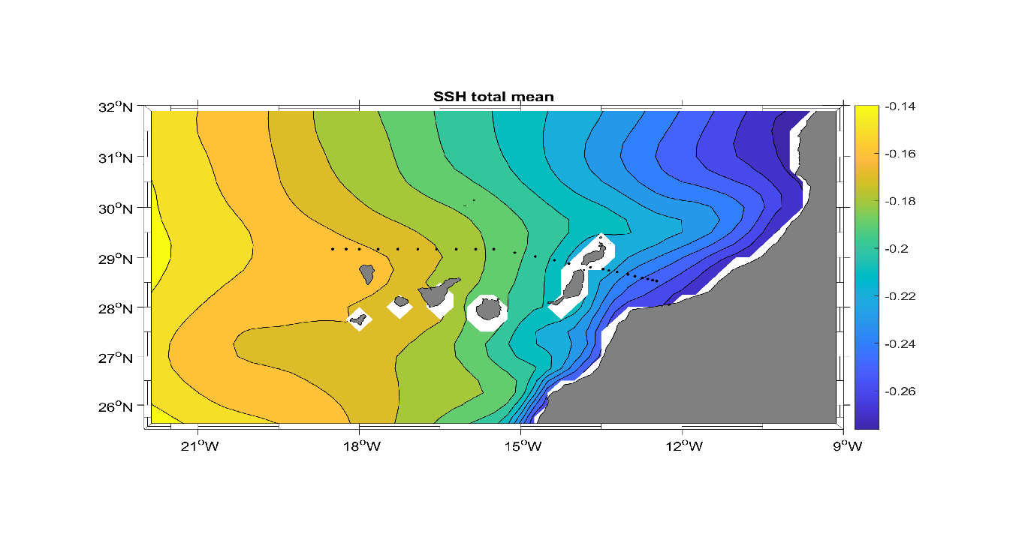
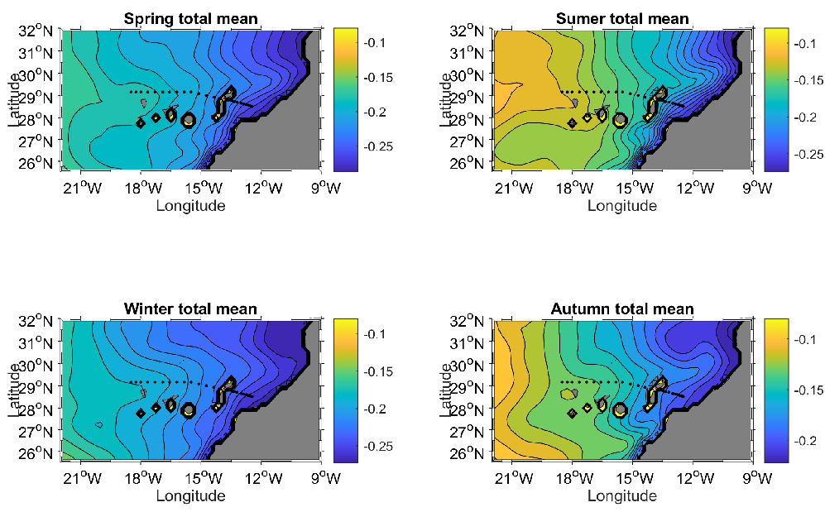
RESULTS PHYSICAL OCEANOGRAPHIC GROUP (IOCAG-ULPGC)
1,757,54,28€
12
1999-2019

Slide 9
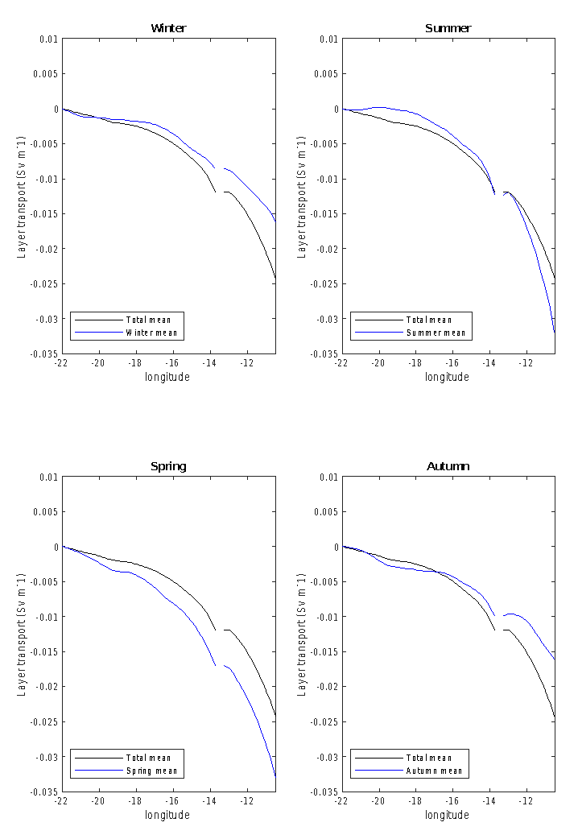
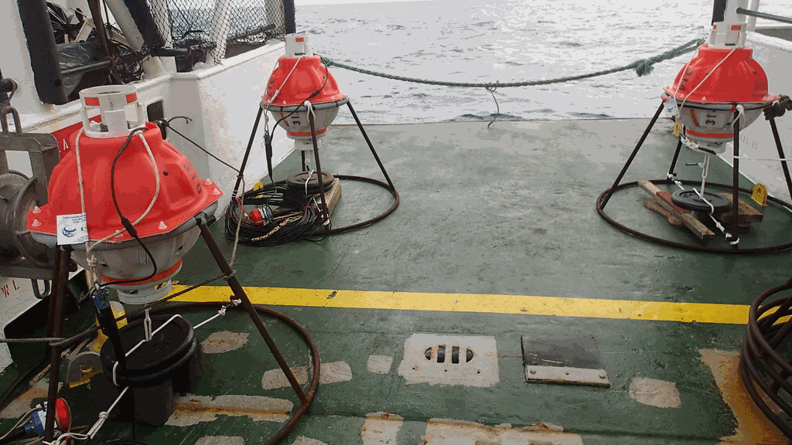
RESULTS PHYSICAL OCEANOGRAPHIC GROUP (IOCAG-ULPGC)
1,757,54,28€
12
Pressure Inverted Echo Sounders (PIES)

Slide 10
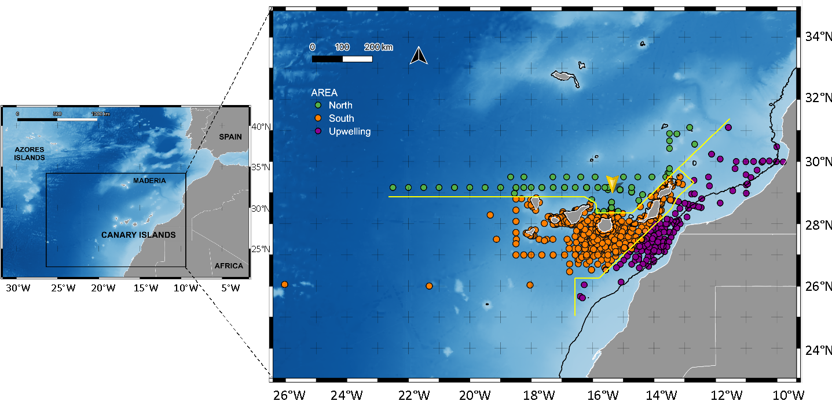
Location of zooplankton data
AÑO 2020
AÑO 2021
AÑO 2022

Slide 11
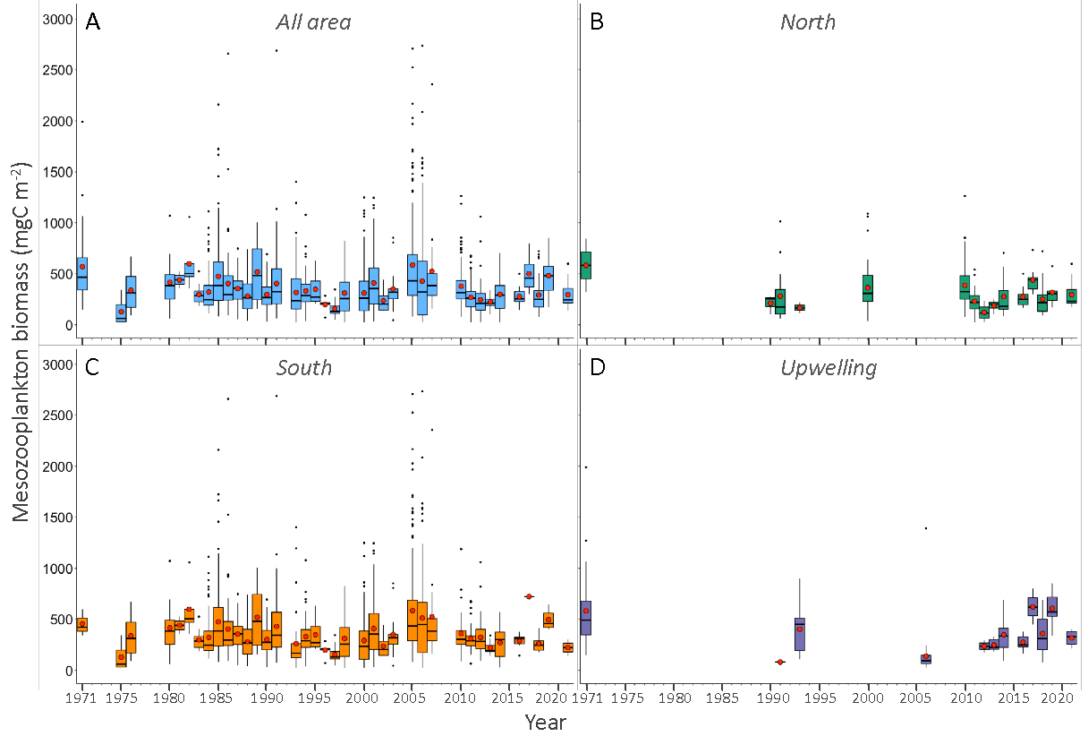
Time-series of zooplankton (1971-2021)
AÑO 2020
AÑO 2021
AÑO 2022

Slide 12
02
TIDES

Slide 13
MAC-Clima
Final product
1
Society and awareness-raising
2.2.1.
2
Incentive schemes / adaptation
MAC-Clima
Activities
TIDES Research areas
3
Energy transition
2.3.1.
4
Risks and vulnerability

Slide 14
AÑO 2020
AÑO 2021
AÑO 2022
 | TIDES AREAS | Act. | ACTIONS | FINAL PRODUCT | TIDES DELIVERABLES
1 | SOCIETY AND AWARENESS-RAISING | 2.3.1. | Understand society's perception and knowledge of climate change and its risks Assessing the preferences of the resident population and tourists | Analytical report on citizens' perceptions of climate change | Experiments with society: Measuring change in social attitudes towards adaptation policies and their willingness to sacrifice versus the way information on Climate Change is presented (Canary Islands, Azores and Madeira) How the impact of double dividend tourism policies that promote decarbonisation and minimise overtourism in the destination determine a change in the perception and attitude of residents towards tourists (Canary Islands and Senegal)
 |  | 2.2.1. | Assessing changes in resident populations' perceptions of tourism as a consequence of the industry's commitment to decarbonisation | Feasibility study of demonstrative actions for the optimal design of policies for adaptation to climate change in tourism
2 | INCENTIVE SCHEMES / ADAPTATION | 2.2.1. | Prioritising tourism adaptation policies and measures by integrating scientific information and institutional preferences |  | Co-designing climate change adaptation trajectories for the tourism sector in the Canary Islands, Azores, Madeira, Senegal and Mauritania (Soclimpact Synergies)
3 | ENERGY TRANSITION | 2.2.1. | Assessment of decarbonisation actions in tourism, contributing to adaptation | Energy recommendations | Experimental design to promote Energy Communities in tourist municipalities (continuity)
4 | RISKS AND VULNERABILITY | 2.2.1. | Vulnerability and risk assessment | Vulnerability studies and recommendations for mitigation measures | Comparative risk projection study (until 2100) European islands (Soclimpact synergies - forest fires, Thermal stress and marine habitat degradation)
Notes:
Actividad 2.2.1. Elaborar diversos análisis de la vulnerabilidad del espacio de cooperación ante el cambio climático para poder proponer y establecer medidas de adaptación y mitigación de los riesgos derivados del mismo y disminuir la vulnerabilidad de distintas áreas y sectores clave del espacio de cooperación
Actividad 2.3.1. Conocer la percepción sobre el cambio climático que tiene la población del espacio de cooperación vulnerable o potencialmente vulnerable a éste con el propósito de promover y fortalecer el proceso de adaptación y mitigación, sensibilización y apropiación social del conocimiento asociado al fenómeno

Slide 15
AÑO 2020
AÑO 2021
AÑO 2022
 | TIDES AREAS | Act. | ACTIONS | FINAL PRODUCT | TIDES DELIVERABLES
1 | SOCIETY AND AWARENESS-RAISING | 2.3.1. | Understand society's perception and knowledge of climate change and its risks Assessing the preferences of the resident population and tourists | Analytical report on citizens' perceptions of climate change | Experiments with society: Measuring change in social attitudes towards adaptation policies and their willingness to sacrifice versus the way information on Climate Change is presented (Canary Islands, Azores and Madeira) How the impact of double dividend tourism policies that promote decarbonisation and minimise overtourism in the destination determine a change in the perception and attitude of residents towards tourists (Canary Islands and Senegal)
 |  | 2.2.1. | Assessing changes in resident populations' perceptions of tourism as a consequence of the industry's commitment to decarbonisation | Feasibility study of demonstrative actions for the optimal design of policies for adaptation to climate change in tourism
2 | INCENTIVE TO ADOPT APPROPRIATE POLICIES | 2.2.1. | Prioritising tourism adaptation policies and measures by integrating scientific information and institutional preferences |  | Co-designing climate change adaptation trajectories for the tourism sector in the Canary Islands, Azores, Madeira, Senegal and Mauritania (Soclimpact Synergies)
3 | ENERGY TRANSITION | 2.2.1. | Assessment of decarbonisation actions in tourism, contributing to adaptation | Energy recommendations | Experimental design to promote Energy Communities in tourist municipalities (continuity)
4 | RISKS AND VULNERABILITY | 2.2.1. | Vulnerability and risk assessment | Vulnerability studies and recommendations for mitigation measures | Comparative risk projection study (until 2100) European islands (Soclimpact synergies - forest fires, Thermal stress and marine habitat degradation)
Notes:
Actividad 2.2.1. Elaborar diversos análisis de la vulnerabilidad del espacio de cooperación ante el cambio climático para poder proponer y establecer medidas de adaptación y mitigación de los riesgos derivados del mismo y disminuir la vulnerabilidad de distintas áreas y sectores clave del espacio de cooperación
Actividad 2.3.1. Conocer la percepción sobre el cambio climático que tiene la población del espacio de cooperación vulnerable o potencialmente vulnerable a éste con el propósito de promover y fortalecer el proceso de adaptación y mitigación, sensibilización y apropiación social del conocimiento asociado al fenómeno

Slide 16
AÑO 2020
AÑO 2021
AÑO 2022
 | TIDES AREAS | Act. | ACTIONS | FINAL PRODUCT | TIDES DELIVERABLES
1 | SOCIETY AND AWARENESS-RAISING | 2.3.1. | Understand society's perception and knowledge of climate change and its risks Assessing the preferences of the resident population and tourists | Analytical report on citizens' perceptions of climate change | Experiments with society: To study changes in resident attitudes towards CC adaptation policies and their willingness to sacrifice in relation to the way CC information is presented (Canary Islands, Azores and Madeira). How the inherent trade-off between policies that reduce emissions and overtourism in the destination determines changes in the perception and attitude of residents towards tourists (Canary Islands and Senegal).
 |  | 2.2.1. | Assessment of changes in resident populations' perceptions of tourism as a consequence of the industry's commitment to decarbonisation | Feasibility study of demonstrative actions for the optimal design of policies for adaptation to climate change in tourism
2 | INCENTIVE TO ADOPT APPROPRIATE POLICIES | 2.2.1. | Prioritising tourism adaptation policies and measures by integrating scientific information and institutional preferences |  | Co-designing CC adaptation trajectories for the tourism sector in the Canary Islands, Azores, Madeira, Senegal and Mauritania
3 | ENERGY TRANSITION | 2.2.1. | Assessment of decarbonisation actions in tourism, contributing to adaptation | Energy recommendations | Experimental design to promote Energy Communities in tourist municipalities (continuity)
4 | RISKS AND VULNERABILITY | 2.2.1. | Detección de las vulnerabilidades y riesgos a los que se enfrentan las regiones | Vulnerability studies and recommendations for mitigation measures | Comparative risk projection study (until 2100) European islands
Notes:
Actividad 2.2.1. Elaborar diversos análisis de la vulnerabilidad del espacio de cooperación ante el cambio climático para poder proponer y establecer medidas de adaptación y mitigación de los riesgos derivados del mismo y disminuir la vulnerabilidad de distintas áreas y sectores clave del espacio de cooperación
Actividad 2.3.1. Conocer la percepción sobre el cambio climático que tiene la población del espacio de cooperación vulnerable o potencialmente vulnerable a éste con el propósito de promover y fortalecer el proceso de adaptación y mitigación, sensibilización y apropiación social del conocimiento asociado al fenómeno

Slide 17
AÑO 2020
AÑO 2021
AÑO 2022
 | TIDES AREAS | Act. | ACTIONS | FINAL PRODUCT | TIDES DELIVERABLES
1 | SOCIETY AND AWARENESS-RAISING | 2.3.1. | Understand society's perception and knowledge of climate change and its risks Assessing the preferences of the resident population and tourists | Analytical report on citizens' perceptions of climate change | Experiments with society: To study changes in resident attitudes towards CC adaptation policies and their willingness to sacrifice in relation to the way CC information is presented (Canary Islands, Azores and Madeira). How the inherent trade-off between policies that reduce emissions and overtourism in the destination determines changes in the perception and attitude of residents towards tourists (Canary Islands and Senegal).
 |  | 2.2.1. | Assessment of changes in resident populations' perceptions of tourism as a consequence of the industry's commitment to decarbonisation | Feasibility study of demonstrative actions for the optimal design of policies for adaptation to climate change in tourism
2 | INCENTIVE TO ADOPT APPROPRIATE POLICIES | 2.2.1. | Prioritising tourism adaptation policies and measures by integrating scientific information and institutional preferences |  | Co-designing CC adaptation trajectories for the tourism sector in the Canary Islands, Azores, Madeira, Senegal and Mauritania
3 | ENERGY TRANSITION | 2.2.1. | Assessment of decarbonisation actions in tourism, contributing to adaptation | Energy recommendations | Experimental design to promote Energy Communities in tourist municipalities (continuity)
4 | RISKS AND VULNERABILITY | 2.2.1. | Detección de las vulnerabilidades y riesgos a los que se enfrentan las regiones | Vulnerability studies and recommendations for mitigation measures | Comparative risk projection study (until 2100) European islands
Notes:
Actividad 2.2.1. Elaborar diversos análisis de la vulnerabilidad del espacio de cooperación ante el cambio climático para poder proponer y establecer medidas de adaptación y mitigación de los riesgos derivados del mismo y disminuir la vulnerabilidad de distintas áreas y sectores clave del espacio de cooperación
Actividad 2.3.1. Conocer la percepción sobre el cambio climático que tiene la población del espacio de cooperación vulnerable o potencialmente vulnerable a éste con el propósito de promover y fortalecer el proceso de adaptación y mitigación, sensibilización y apropiación social del conocimiento asociado al fenómeno

Slide 18
Value-Belief-Norm Theory
Social Exchange Theory
Social Representation Theory
Awareness and knowledge about the contribution of tourism to CC
OVERTOURISM IS RESPONSIBLE OF CC IMPACTS
Biospheric and altruistic values (pro-environmental) of residents
H1
Destination’s efforts to promote a neutral carbon tourism industry
H2
Egoistic values of residents
Residents’ willingness to sacrifice
(reduce emissions)
H1: The higher the responsibility that residents attach to tourism and overtourism on the CC impacts, the lower disposition to sacrifice to reduce emissions
H2: Residents’ opinions about the destination’s efforts to promote a neutral carbon tourism industry influence their willingness to sacrifice.

Slide 19
AÑO 2020
AÑO 2021
AÑO 2022
 | TIDES AREAS | Act. | ACTIONS | FINAL PRODUCT | TIDES DELIVERABLES
1 | SOCIETY AND AWARENESS-RAISING | 2.3.1. | Understand society's perception and knowledge of climate change and its risks Assessing the preferences of the resident population and tourists | Analytical report on citizens' perceptions of climate change | Experiments with society: To study changes in resident attitudes towards CC adaptation policies and their willingness to sacrifice in relation to the way CC information is presented (Canary Islands, Azores and Madeira). How the inherent trade-off between policies that reduce emissions and overtourism in the destination determines changes in the perception and attitude of residents towards tourists (Canary Islands and Senegal).
 |  | 2.2.1. | Assessment of changes in resident populations' perceptions of tourism as a consequence of the industry's commitment to decarbonisation | Feasibility study of demonstrative actions for the optimal design of policies for adaptation to climate change in tourism
2 | INCENTIVE TO ADOPT APPROPRIATE POLICIES | 2.2.1. | Prioritising tourism adaptation policies and measures by integrating scientific information and institutional preferences |  | Co-designing CC adaptation trajectories for the tourism sector in the Canary Islands, Azores, Madeira, Senegal and Mauritania
3 | ENERGY TRANSITION | 2.2.1. | Assessment of decarbonisation actions in tourism, contributing to adaptation | Energy recommendations | Experimental design to promote Energy Communities in tourist municipalities (continuity)
4 | RISKS AND VULNERABILITY | 2.2.1. | Detección de las vulnerabilidades y riesgos a los que se enfrentan las regiones | Vulnerability studies and recommendations for mitigation measures | Comparative risk projection study (until 2100) European islands
Notes:
Actividad 2.2.1. Elaborar diversos análisis de la vulnerabilidad del espacio de cooperación ante el cambio climático para poder proponer y establecer medidas de adaptación y mitigación de los riesgos derivados del mismo y disminuir la vulnerabilidad de distintas áreas y sectores clave del espacio de cooperación
Actividad 2.3.1. Conocer la percepción sobre el cambio climático que tiene la población del espacio de cooperación vulnerable o potencialmente vulnerable a éste con el propósito de promover y fortalecer el proceso de adaptación y mitigación, sensibilización y apropiación social del conocimiento asociado al fenómeno

Slide 20
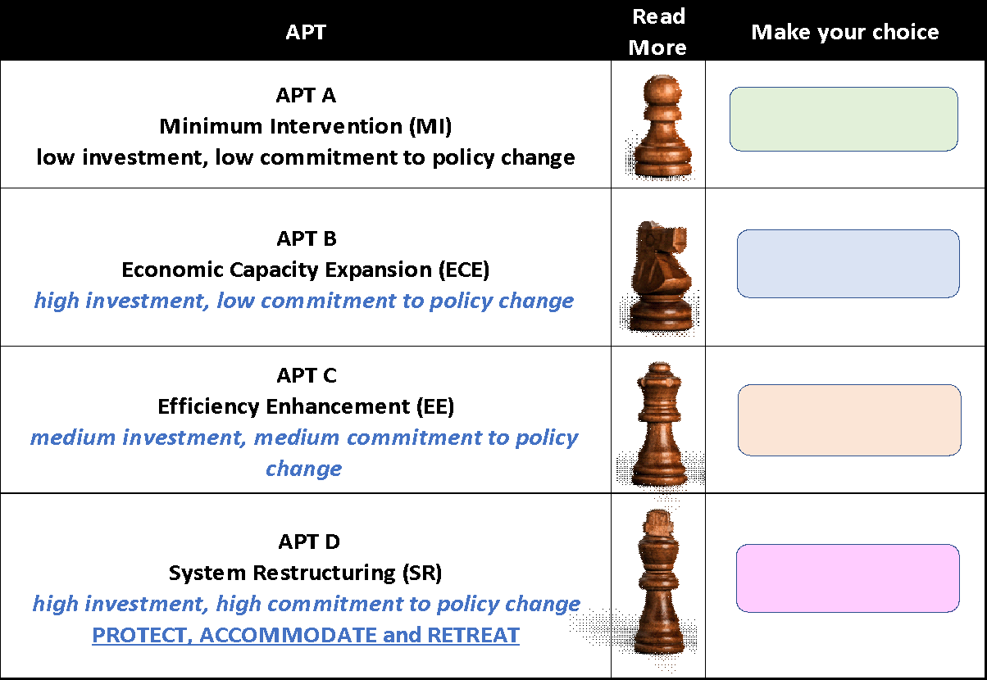
Climate and socioeconomic implications for the island
Background material
Island
Adaptation
Policy
Trajectory
Collective response
(1) vulnerability reduction (2) Disaster Risk Reduction (3) Social-Ecological Resilience

Slide 21
AÑO 2020
AÑO 2021
AÑO 2022
 | TIDES AREAS | Act. | ACTIONS | FINAL PRODUCT | TIDES DELIVERABLES
1 | SOCIETY AND AWARENESS-RAISING | 2.3.1. | Understand society's perception and knowledge of climate change and its risks Assessing the preferences of the resident population and tourists | Analytical report on citizens' perceptions of climate change | Experiments with society: To study changes in resident attitudes towards CC adaptation policies and their willingness to sacrifice in relation to the way CC information is presented (Canary Islands, Azores and Madeira). How the inherent trade-off between policies that reduce emissions and overtourism in the destination determines changes in the perception and attitude of residents towards tourists (Canary Islands and Senegal).
 |  | 2.2.1. | Assessment of changes in resident populations' perceptions of tourism as a consequence of the industry's commitment to decarbonisation | Feasibility study of demonstrative actions for the optimal design of policies for adaptation to climate change in tourism
2 | INCENTIVE TO ADOPT APPROPRIATE POLICIES | 2.2.1. | Prioritising tourism adaptation policies and measures by integrating scientific information and institutional preferences |  | Co-designing CC adaptation trajectories for the tourism sector in the Canary Islands, Azores, Madeira, Senegal and Mauritania
3 | ENERGY TRANSITION | 2.2.1. | Assessment of decarbonisation actions in tourism, contributing to adaptation | Energy recommendations | Experimental design to promote Energy Communities in tourist municipalities (continuity)
4 | RISKS AND VULNERABILITY | 2.2.1. | Detección de las vulnerabilidades y riesgos a los que se enfrentan las regiones | Vulnerability studies and recommendations for mitigation measures | Comparative risk projection study (until 2100) European islands
Notes:
Actividad 2.2.1. Elaborar diversos análisis de la vulnerabilidad del espacio de cooperación ante el cambio climático para poder proponer y establecer medidas de adaptación y mitigación de los riesgos derivados del mismo y disminuir la vulnerabilidad de distintas áreas y sectores clave del espacio de cooperación
Actividad 2.3.1. Conocer la percepción sobre el cambio climático que tiene la población del espacio de cooperación vulnerable o potencialmente vulnerable a éste con el propósito de promover y fortalecer el proceso de adaptación y mitigación, sensibilización y apropiación social del conocimiento asociado al fenómeno

Slide 22
AÑO 2020
AÑO 2021
AÑO 2022
 | TIDES AREAS | Act. | ACTIONS | FINAL PRODUCT | TIDES DELIVERABLES
1 | SOCIETY AND AWARENESS-RAISING | 2.3.1. | Understand society's perception and knowledge of climate change and its risks Assessing the preferences of the resident population and tourists | Analytical report on citizens' perceptions of climate change | Experiments with society: To study changes in resident attitudes towards CC adaptation policies and their willingness to sacrifice in relation to the way CC information is presented (Canary Islands, Azores and Madeira). How the inherent trade-off between policies that reduce emissions and overtourism in the destination determines changes in the perception and attitude of residents towards tourists (Canary Islands and Senegal).
 |  | 2.2.1. | Assessment of changes in resident populations' perceptions of tourism as a consequence of the industry's commitment to decarbonisation | Feasibility study of demonstrative actions for the optimal design of policies for adaptation to climate change in tourism
2 | INCENTIVE TO ADOPT APPROPRIATE POLICIES | 2.2.1. | Prioritising tourism adaptation policies and measures by integrating scientific information and institutional preferences |  | Co-designing CC adaptation trajectories for the tourism sector in the Canary Islands, Azores, Madeira, Senegal and Mauritania
3 | ENERGY TRANSITION | 2.2.1. | Assessment of decarbonisation actions in tourism, contributing to adaptation | Energy recommendations | Experimental design to promote Energy Communities in tourist municipalities (continuity)
4 | RISKS AND VULNERABILITY | 2.2.1. | Detección de las vulnerabilidades y riesgos a los que se enfrentan las regiones | Vulnerability studies and recommendations for mitigation measures | Comparative risk projection study (until 2100) European islands
Notes:
Actividad 2.2.1. Elaborar diversos análisis de la vulnerabilidad del espacio de cooperación ante el cambio climático para poder proponer y establecer medidas de adaptación y mitigación de los riesgos derivados del mismo y disminuir la vulnerabilidad de distintas áreas y sectores clave del espacio de cooperación
Actividad 2.3.1. Conocer la percepción sobre el cambio climático que tiene la población del espacio de cooperación vulnerable o potencialmente vulnerable a éste con el propósito de promover y fortalecer el proceso de adaptación y mitigación, sensibilización y apropiación social del conocimiento asociado al fenómeno

Slide 23
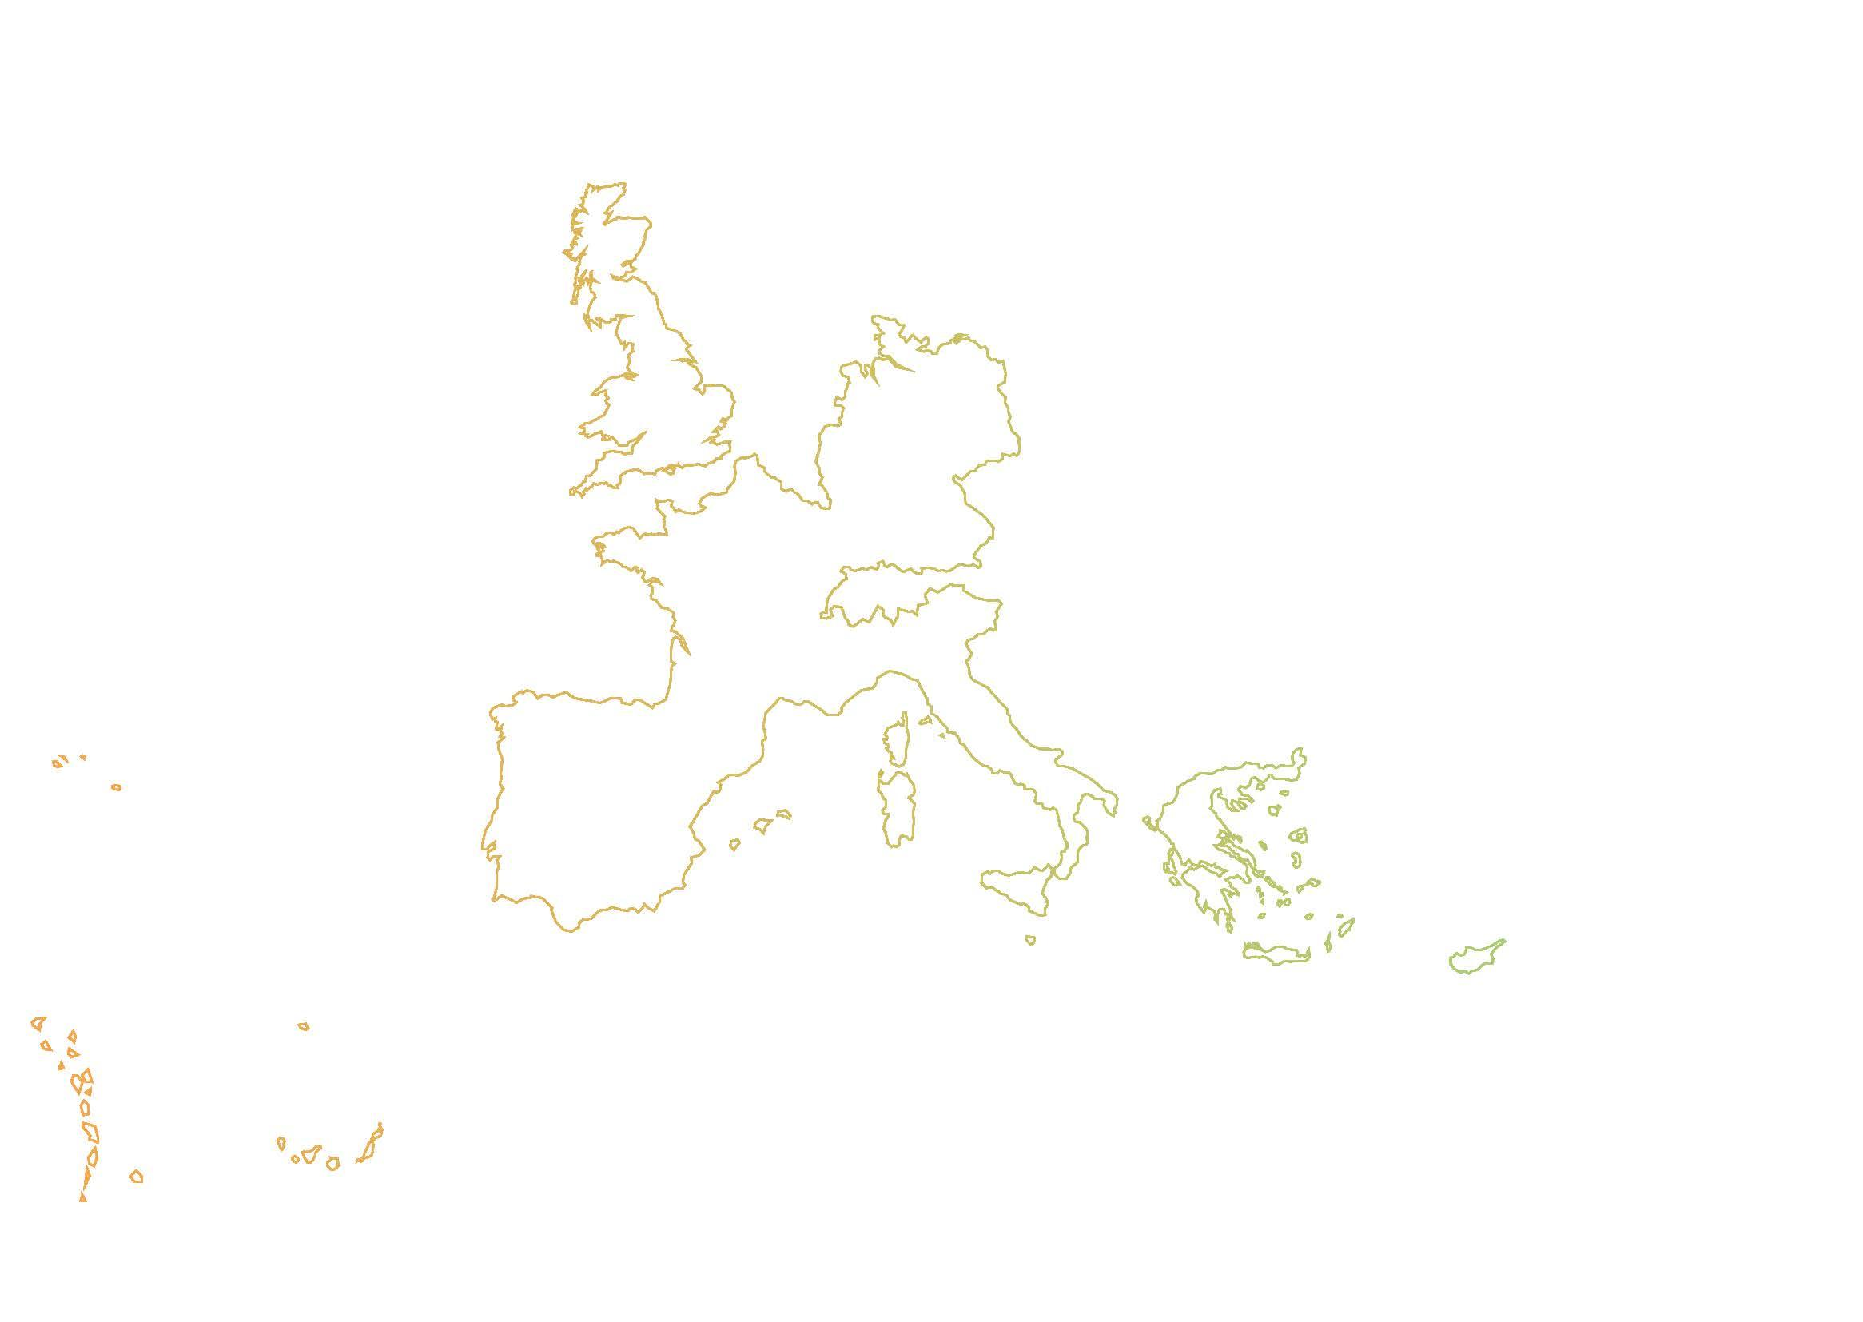
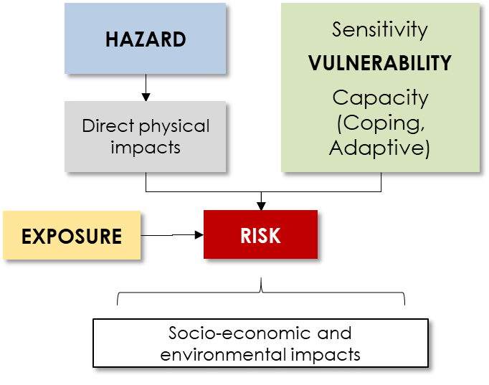
Comparison of risk between islands
Azores
Today
2050
2100
Cape Verde
C. Islands
Today
2050
2100
Today
2050
2100
forest fires
heat waves
marine habitat degradation

Slide 24
Gracias
Obrigado
Merci Beaucoup
THANK YOU

