Slide 1



Taller de formación técnico MAC-CLIMA sobre meteorología y oceanografía para entender el cambio climático
Observaciones e investigación de intrusiones de polvo atmosférico en un contexto de cambio climático
17 de mayo de 2022 (online)
Emilio Cuevas
Centro de Investigación Atmosférica de Izaña
Agencia Estatal de Meteorología (AEMET)

Slide 2
Limitations for long-term monitoring of dust intrusions
1. We cannot measure “dust”, but a cocktail of aerosols
Dust must be discriminated/estimated
2. Observation periods of dust-proxies are quite limited in time (or dust proxies are very inaccurate)
  Reduced visibility (weather services-airports) (1980 at the Canary Islands)
  PM10 vs D10? (air quality networks) (2001)
  Aerosol optical depth (AOD) from ground photometers(2005)
  AOD from satellite borne platforms (research) (1997)
  Aerosol extinction (vertical profiles) from lidars (research) (2010)
3. Which parameter should we use and what thresholds for each of them to define a dust storm?
4.Observations made at one location may have little or no similarity to those observed
at other relatively nearby locations.
5. Relationship between observed changes in dust-related proxies and atmospheric processes are relatively well known, but not the future changes in most of the atmospheric processes driven by climate change

Slide 3
The mineral dust Observation and Prediction systems that we have today:
The Izaña Observatory: a large scientific facility for atmospheric observation (https://izana.aemet.es/)
The air quality network of the Government of the Canary Islands (https://www3.gobiernodecanarias.org/medioambiente/calidaddelaire/)
AEROSPAIN (https://aerospain.aemet.es/)
Barcelona Dust regional Centre (https://dust.aemet.es/)
Satellite information (https://giovanni.gsfc.nasa.gov/giovanni/)

Slide 4
Many people have the perception that there is more dust in the atmosphere now than years ago.
Many people think that a warmer atmosphere and a desertification scenario in North Africa would support that perception.
BUT
If you can not measure it, you can not improve it
(Lord Kelvin)

Slide 5
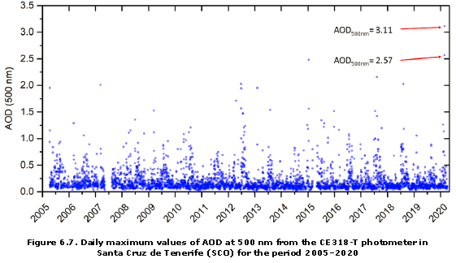
What we know… Observations (1/5)
Ground based AOD and AE Observations from AERONET and GAW-PFR networks
Data series (WMO GAW Report N0 259, 2021)
Historical record
Cuevas et al. (2021)
+ Second historical record on 14-21 Jan 2022: The longest winter dust intrusion the Canary Islands recorded with accurate quantitative information

Slide 6
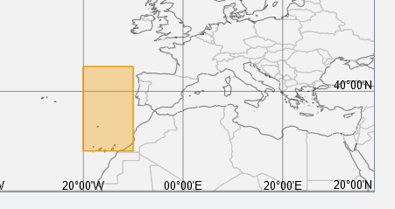
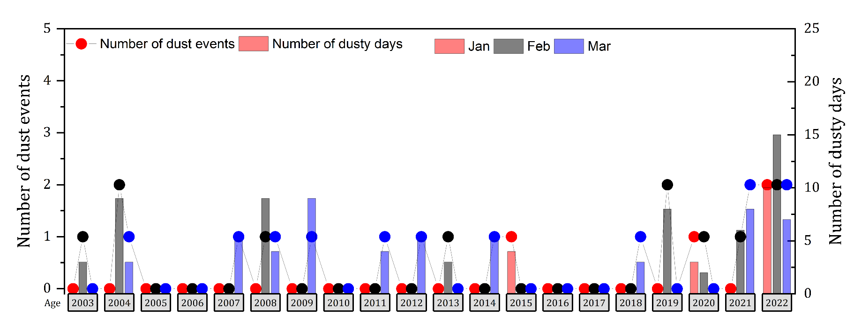
What we know… Observations (2/5)
Modis combined Dark-Target and Deep-Blue AOD
Winters (JFM) 2003-2022
Ongoing study (Cuevas & García et al., 2022)
NO trends…. Increased dust episodes in wintertime since 2020 !!!
Why???
Increase of Cut-off lows in the subtropical region consistent with increase of blocking systems in mid- high latitudes?

Slide 7
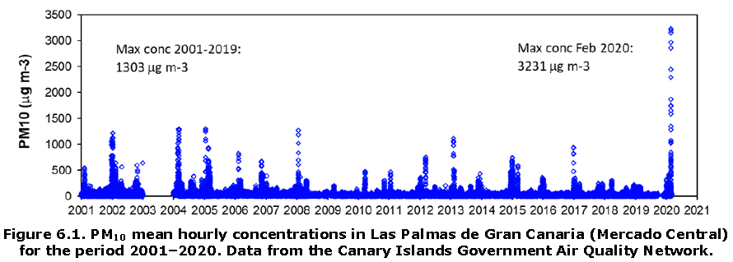
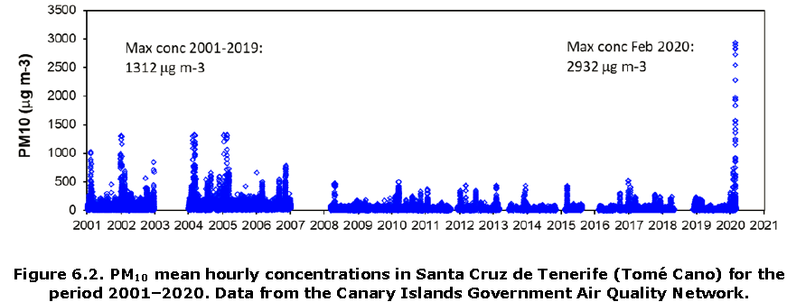
What we know… Observations (3/5)
Cuevas et al. (2021)
Historical record

Slide 8
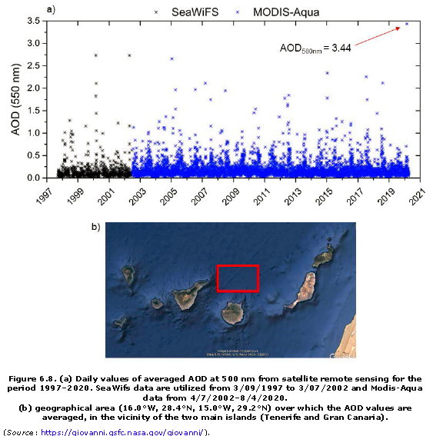
What we know… Observations (4/5)
Historical record
Cuevas et al. (2021)

Slide 9
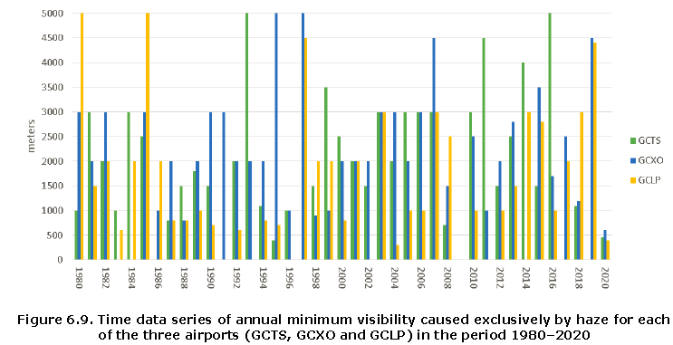
What we know… Observations (5/5)
Historical record
Cuevas et al. (2021)
Ongoing study carried out by David Suarez using SYNOP horizontal visibility (<10 km) Observations at 7 airports of the Canary islands since 1980 suggests no significant trends or slight negative trends !!!

Slide 10

What we know… Research
Atmospheric mechanisms vary greatly from one site to another
Atmospheric mechanisms vary greatly from one season to another
The Canary Islands are an excellent laboratory to learn about atmospheric changes that are taking place in the subtropical region of the North Atlantic and might modulate dust intrusions

Slide 11
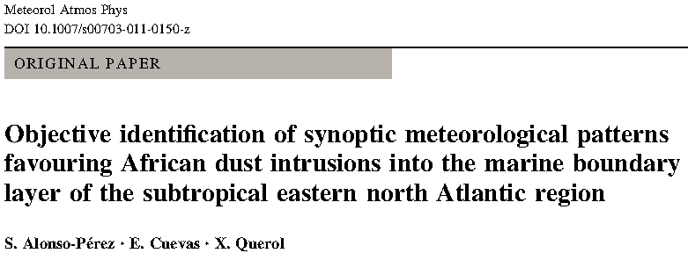
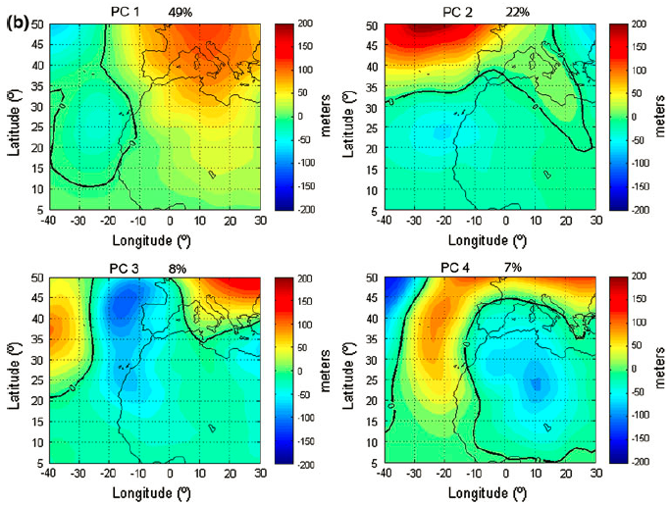
What we know… Research
Alonso-Pérez et al. (2011)
Synoptic geopotential height anomalies patterns (at 1000, 925, 850 and 500 hPa)
favouring African dust outbreaks into the marine
boundary layer (MBL) of the subtropical Eastern North
Atlantic Region (SENAR) were objectively identified by using K-means and Principal Components

Slide 12
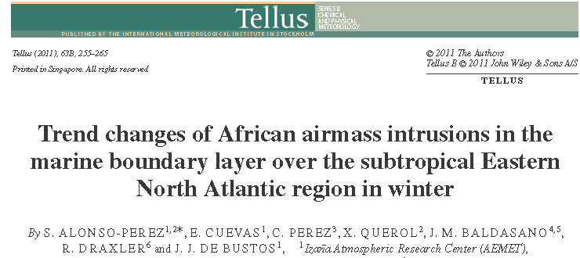
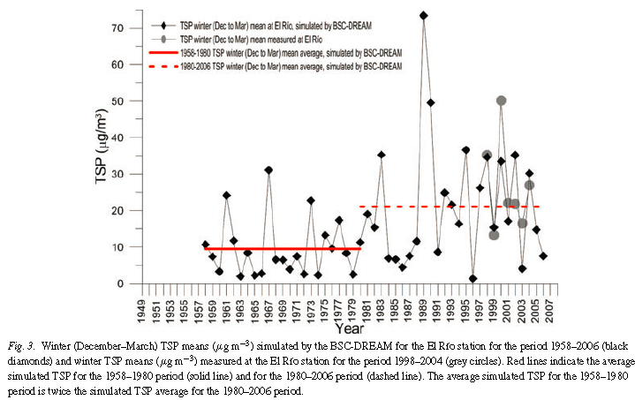
What we know… Research
Alonso-Pérez et al. (2011)

Slide 13
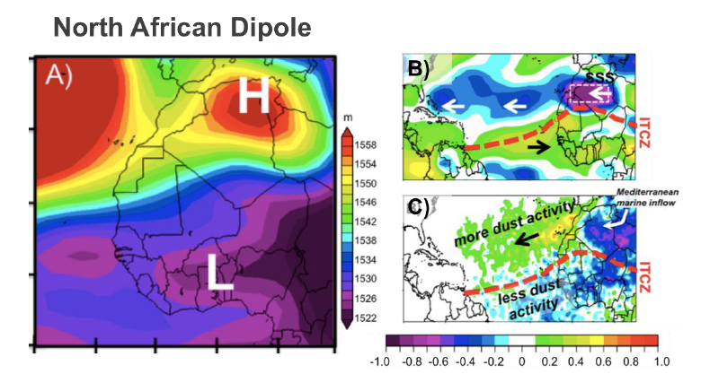
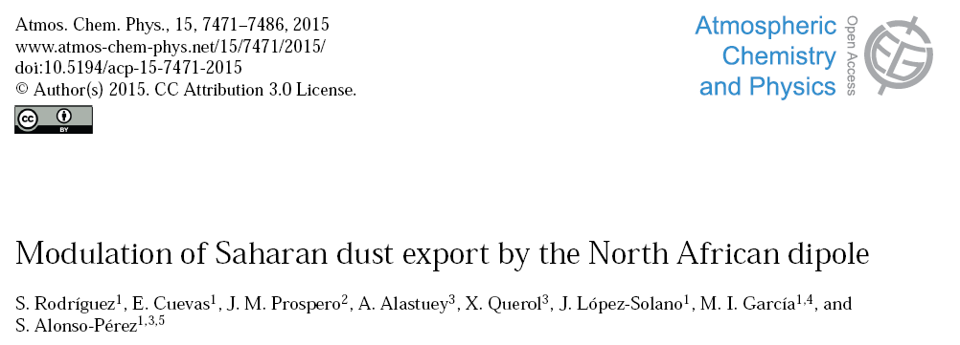
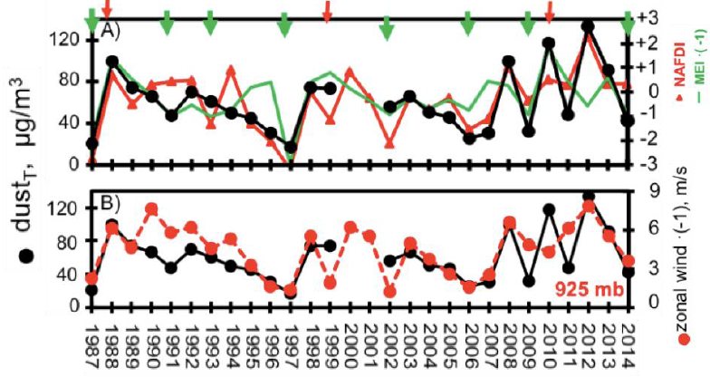
What we know… Research
Rodríguez et al. (2015)

Slide 14
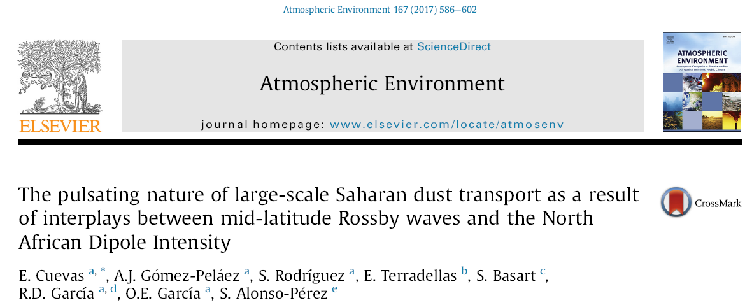
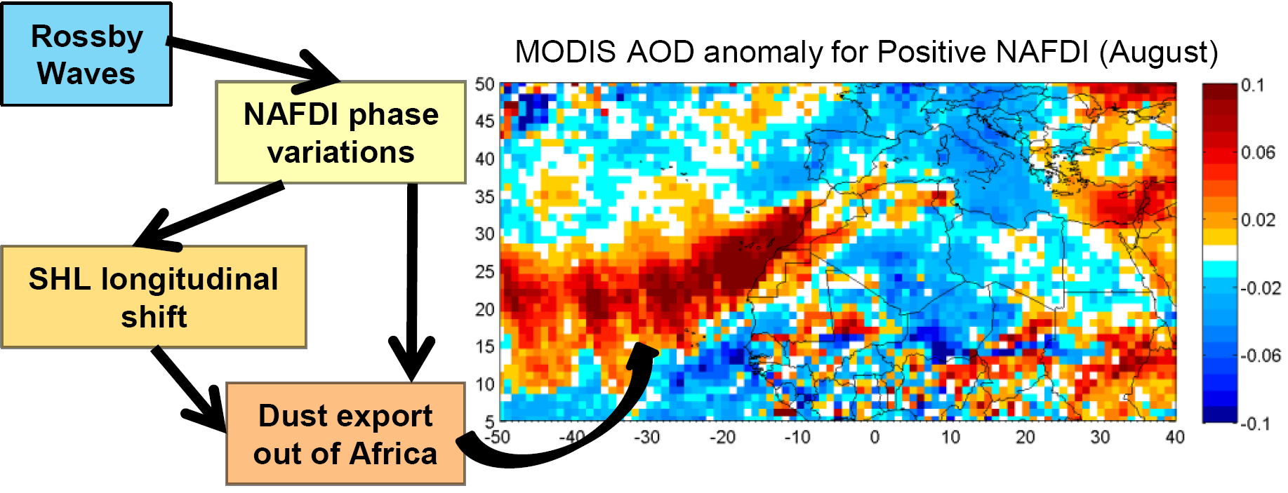
What we know… Research
NAFDI
Saharan Heat Low
Rossby waves
Dust transport
Cuevas et al. (2017)

Slide 15
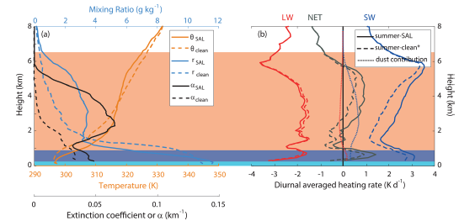
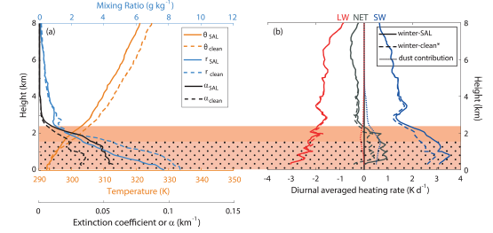
What we know… Research
Important role that both dust and water vapour play in the radiative balance within the summer-SAL and winter-SAL.
The SAL can impact heterogeneous ice nucleation processes through the frequent occurrence of mid-level clouds observed near the SAL top at relatively warm temperatures.
Barreto et al. (2022 a)
Summer
The summer-SAL has been characterised as a dust-laden layerstrongly affecting both the MBL (1 DC48% relative to clean conditions) and the FT. Desert dust is present up to 6.0 km, the SAL top based on the altitude of SAL’s temperature inversion.
In the winter-SAL scenario, the dust layer is confined to lower levels below 2 km altitude. This layer is characterised by a dry anomaly at lower levels, and a dust peak at ~1.3 km height. Clean FT conditions were found above 2.3 km.
Winter

Slide 16
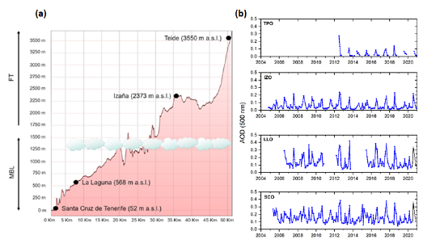
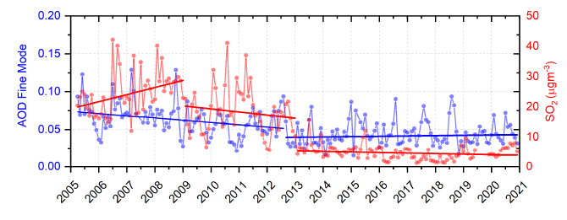
What we know… Research
Barreto et al. (2022 b)
No trends in total AOD
at any of the four AERONET stations in Tenerife (from sea level up to 3555m a.s.l.) !!!!
But…
Dramatic decrease in fine aerosols at Santa Cruz de Tenerife (SCO) after almost total shutdown of the refinery

Slide 17
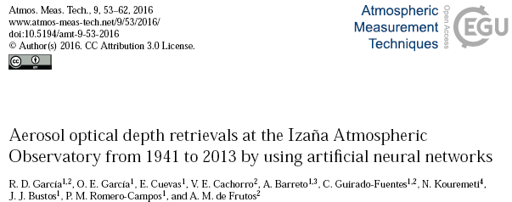
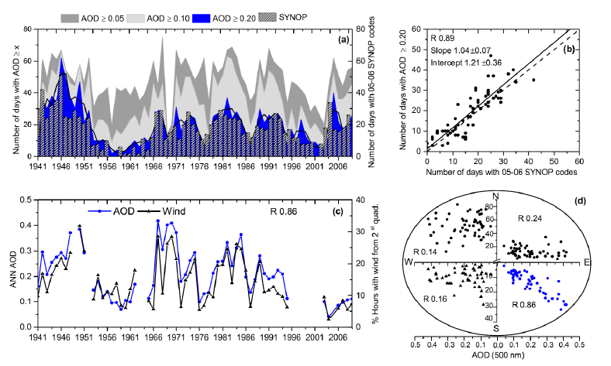
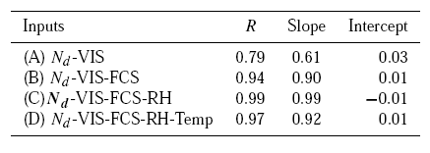
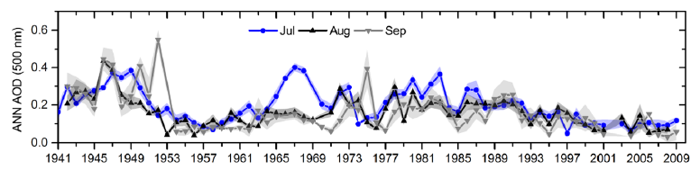
What we know… Research
García et al. (2016)
Excellent agreement between independent observations!!
In agreement with preliminary results from D. Suarez since 1980: Negative trend
Positive or negative trends depending on the time frame we choose: negative trend throughout the series but great uncertainty about its representativeness.
Are there long-term cycles (50 years)?

Slide 18
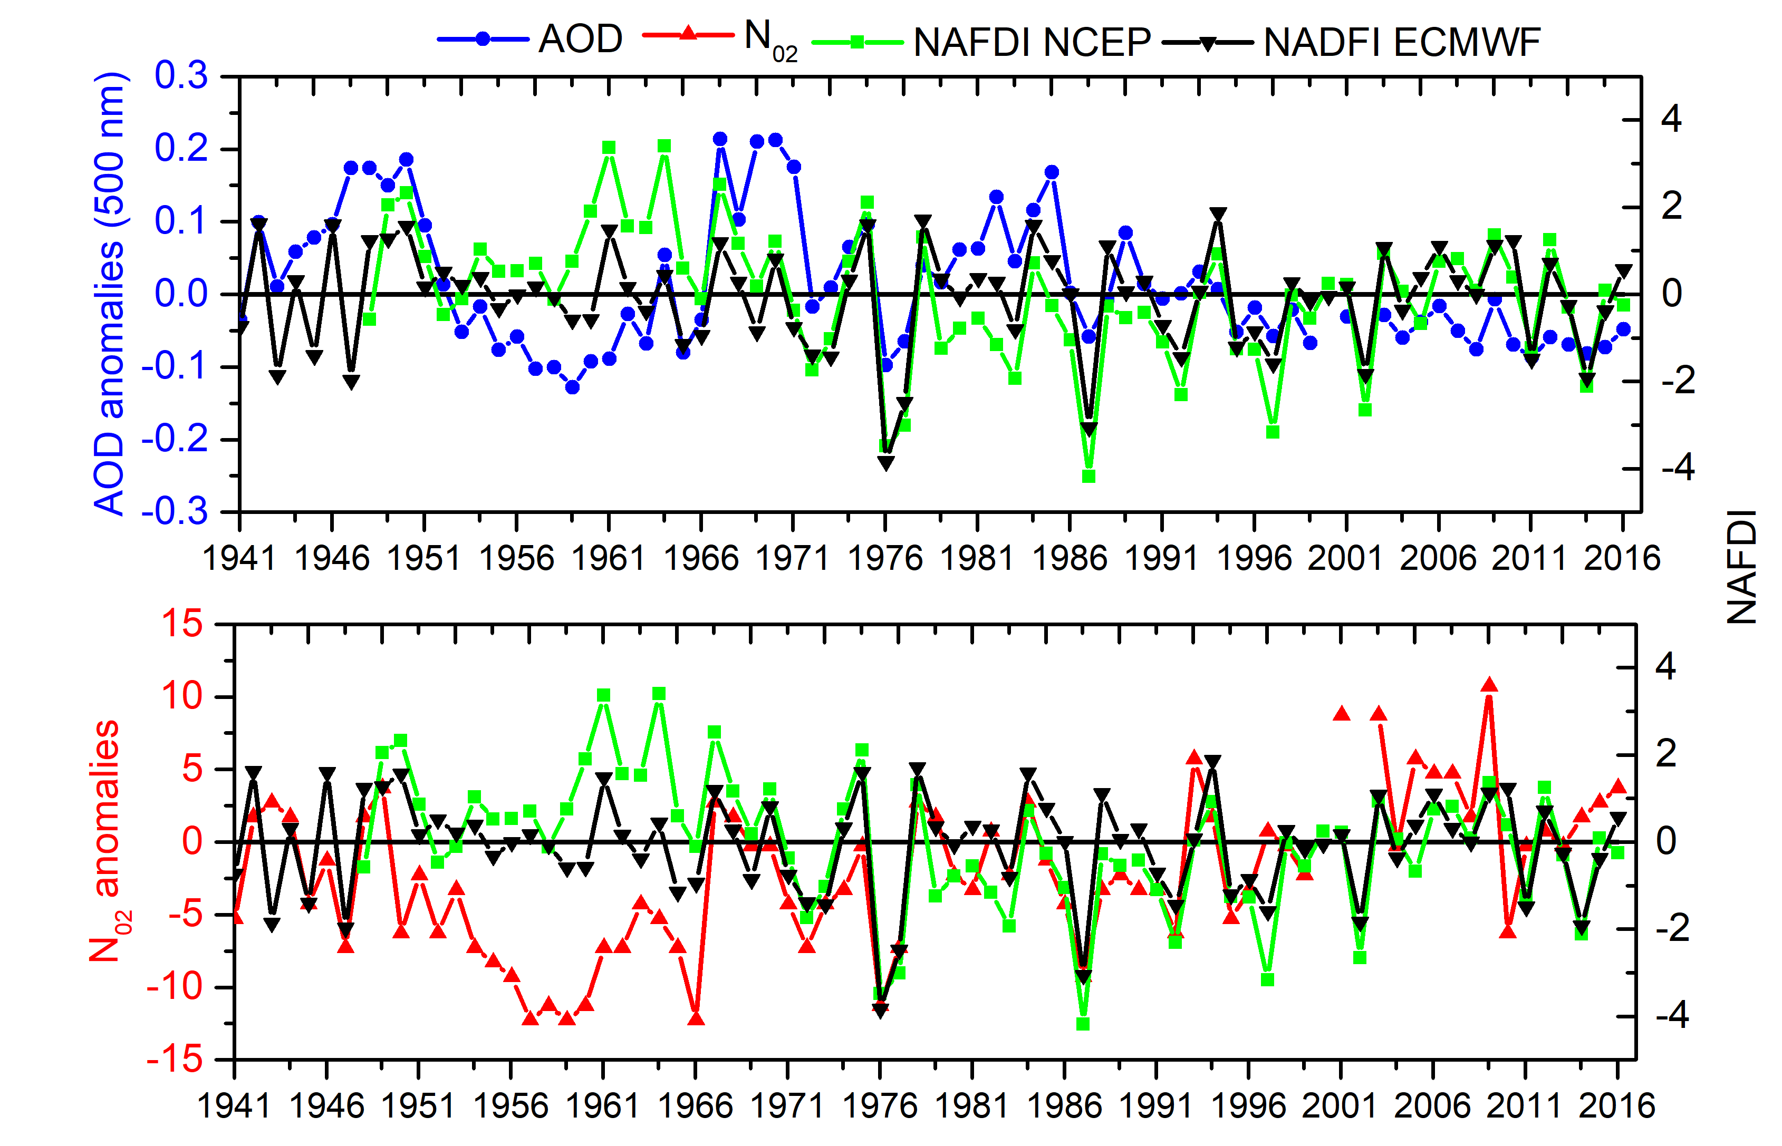
ECMWF: 1941-2010 ERA-20C
2011-2016 ERA-Interim
(ongoing investigation)

Slide 19
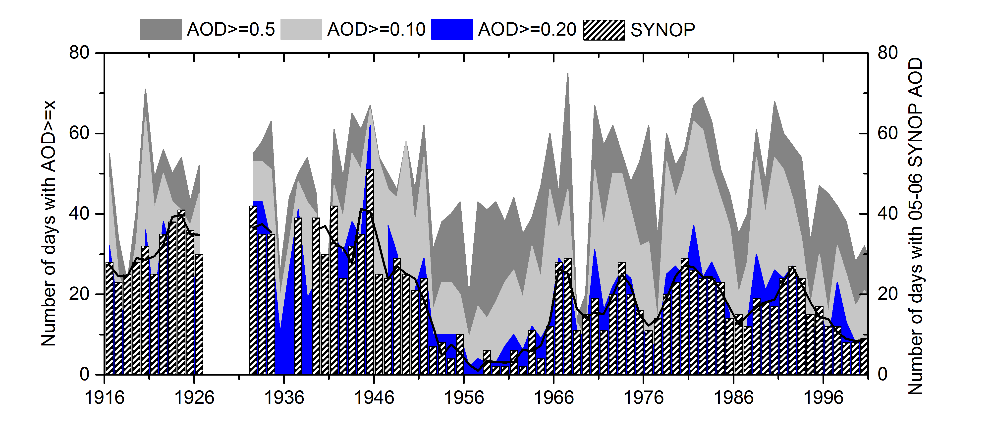
What we know… Research
106 years of dust intrusions !!
No trend is observed
Rosa García (ongoing investigation)

Slide 20
What we don’t know yet:
The changes that we could detect in dust intrusions are not only due to changes in atmospheric processes but also to changes in land use and/or desertification processes, caused, in turn, and in part, by climate change.
Climate models do not include dust nor can they predict what the pressure centers
will be like in the coming decades
Are the possible changes that we recently observe in dust intrusions are circumstantial or are they already being modulated by climate change?
We need precise observations and more research in the coming years !!
….But not only at the Canary Islands

Slide 21

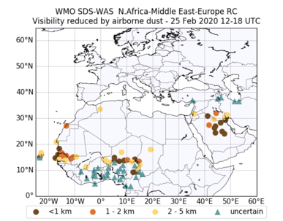

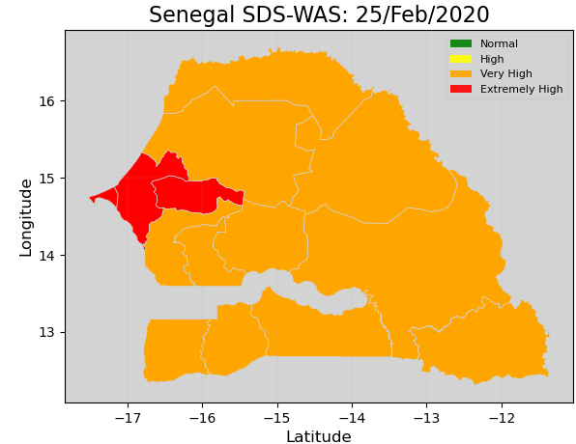
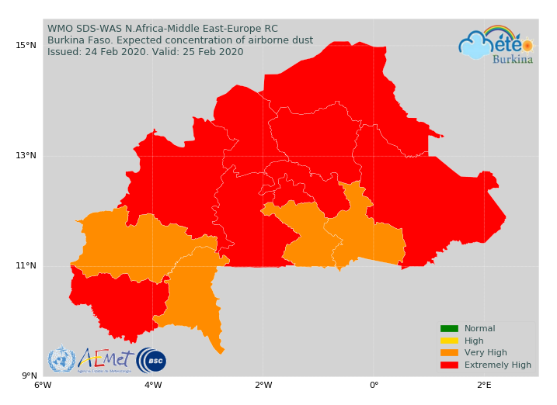
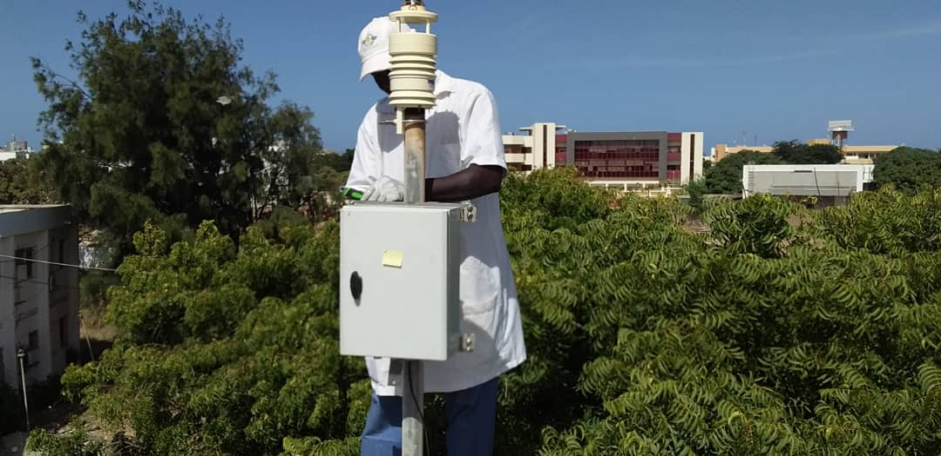
SDS Warning Advisory System for West Africa:
Working since Oct 2018 in Burkina Faso
Developed by WMO – Barcelona Dust Regional Center
Main tasks:
PM sensor and hand-held sunphotometer
SDS Warning System
On line training workshops
Countries involved:
Burkina Faso-Mali-Niger-Chad (CREWS)
Senegal-Cabo Verde-Mauritania (Mac-CLIMA Interreg)
PM sensor being installed on ANACIM building, Dakar, Senegal

Slide 22
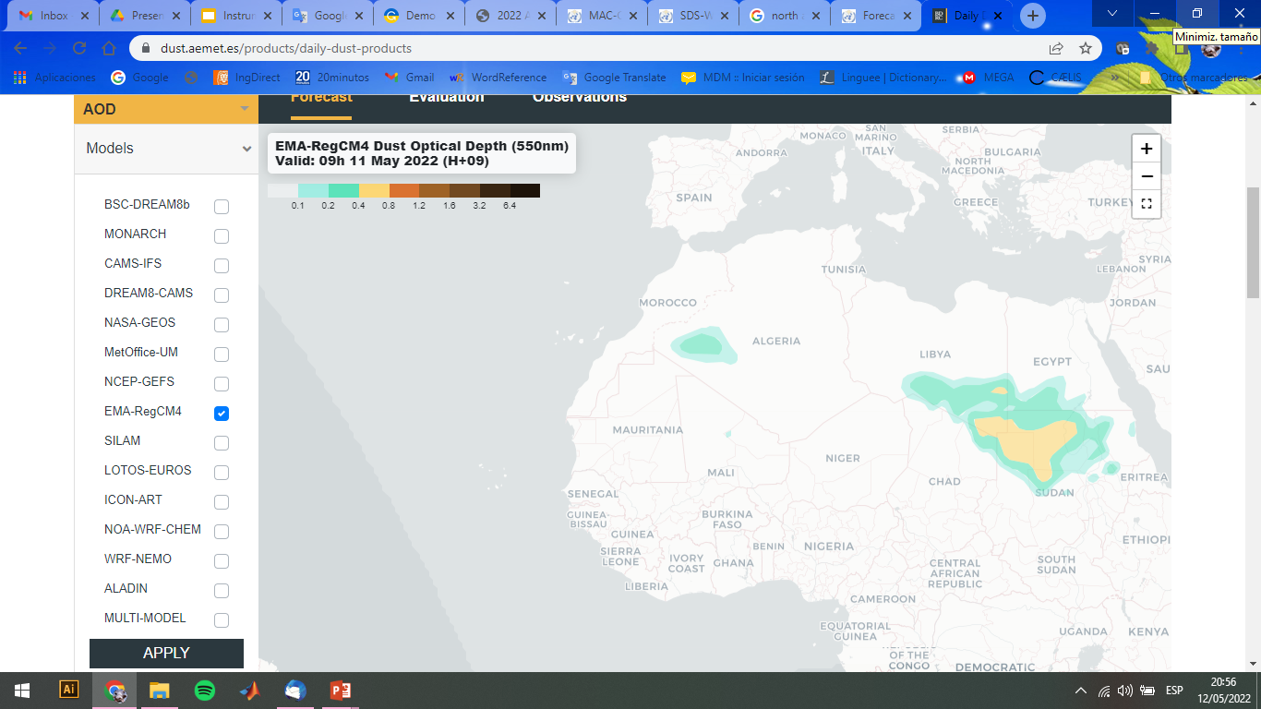
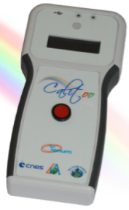
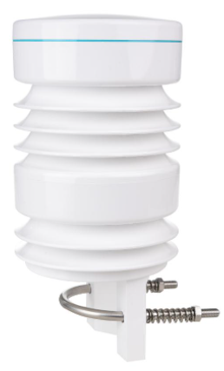


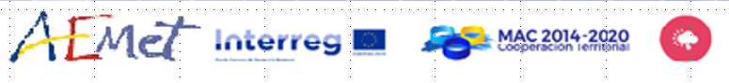
INSTRUMENTS AT THE SITES
+
Calitoo hand-held sun photometer
IMDS: Low-cost PM sensor + Weather station
Dakar
Niamey
Yamena
PROJECT NAME
Nuakchot
Bamako
Praia
Ouagadougou
This Project is managed by África Barreto and Ernest Werner (AEMET)

Slide 23
Conclusions
We have no evidence of significant trends in any of the parameters used as mineral dust proxies.
Since 2020, a sharp increase in dust intrusions has been observed in winter, but we still do not know (it is very soon) if these are circumstantial episodes or are a consequence of changes in atmospheric processes (deep lows and cut-off lows developments) driven by climate change.
In summer, trends depend on the length of the available observed data series. A preliminary study underway indicates that in the period 1916-1950 (hardly affected by climate change) there was more atmospheric dust at Izaña than in recent decades.
Undoubtedly, climate change will modify (or is already doing so) the conditions for the generation and transport of Saharan dust storms, but we still do not know what these changes will be like, when they will occur, or which regions will be most affected in the next decades.

Slide 24
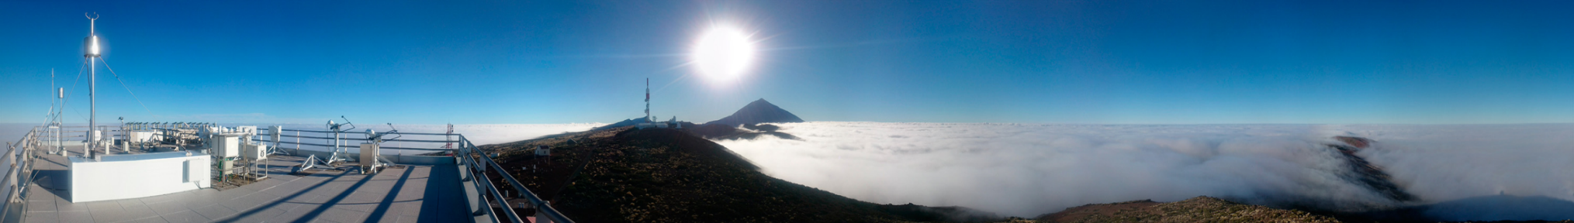
Thank you
106 years observations in the subtropical North Atlantic atmosphere
38 years monitoring atmospheric composition
ecuevasa@aemet.es
http://izana.aemet.es

